Slide 1
Cloud Computing Internship
- Lanka Durga Prasad

Slide 2
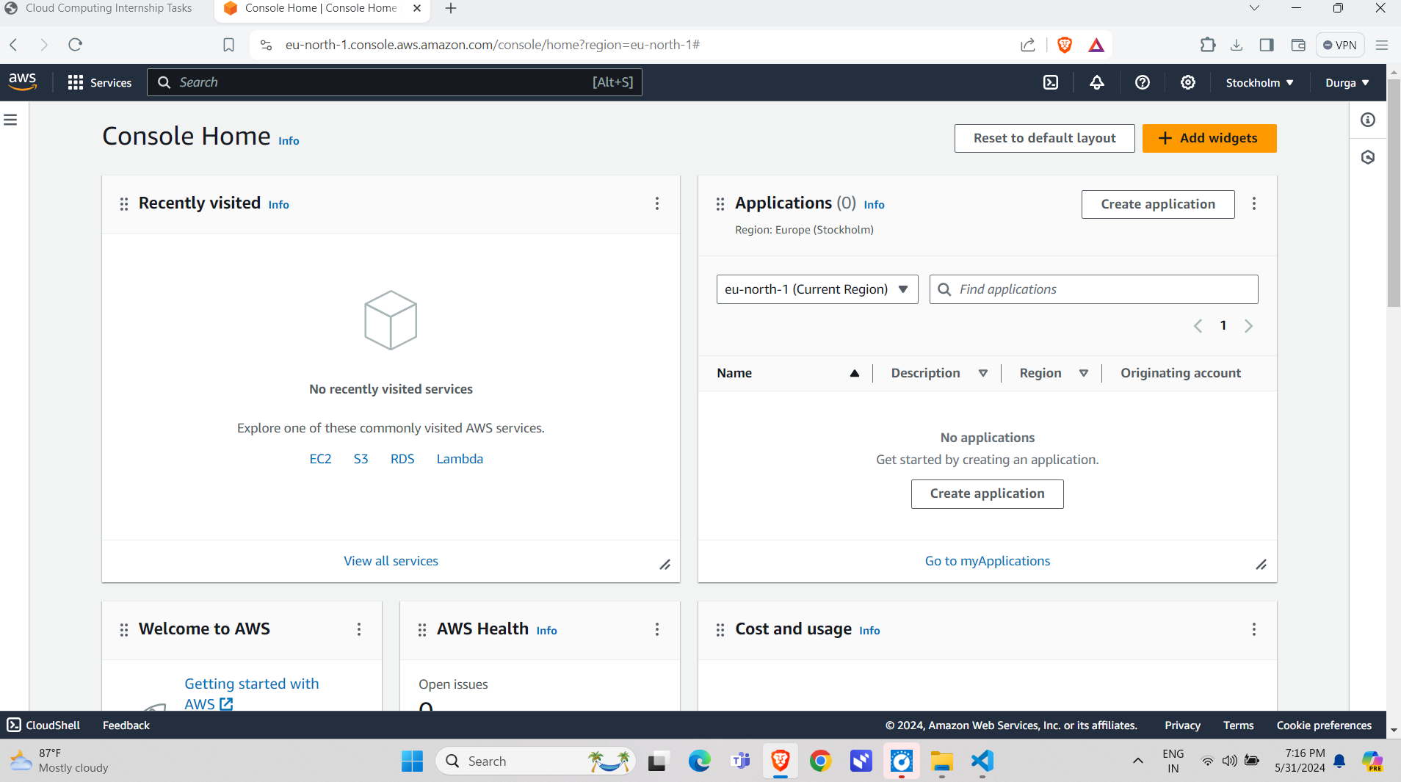
Task 1: Set Up a Basic AWS Environment
After Creating an AWS Free Tier account,the main interface of AWS looks like this:

Slide 3
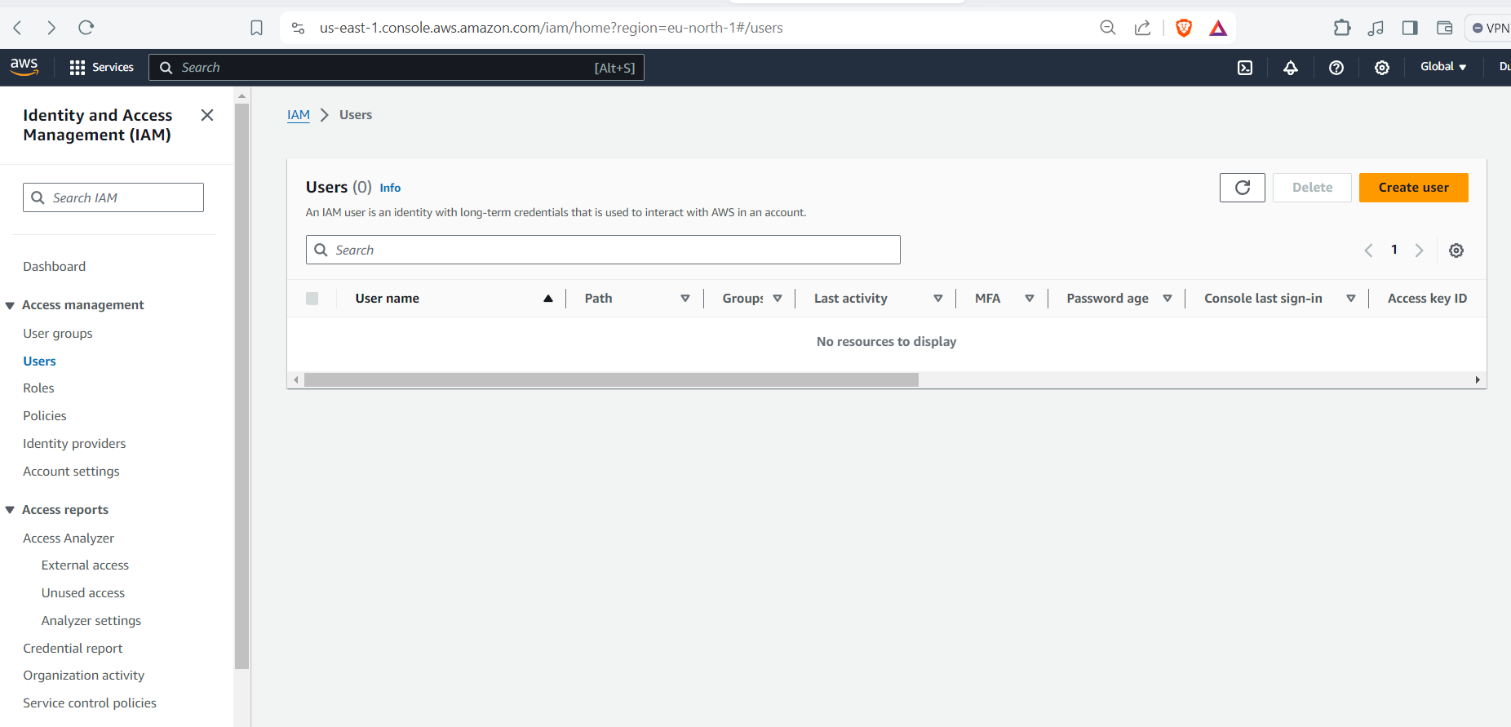
Set up IAM users and roles with specific permissions.
Initially we have to create IAM users

Slide 4
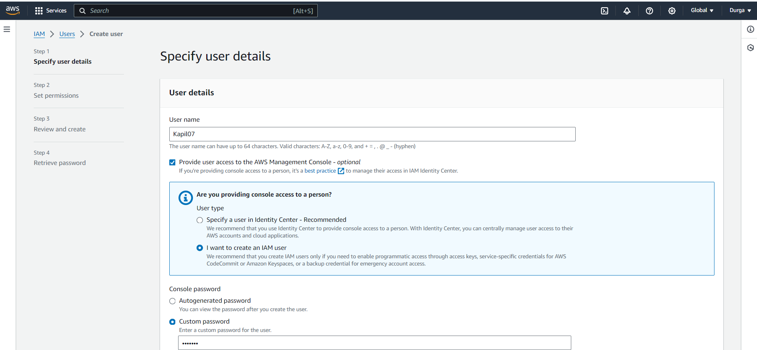

Slide 5
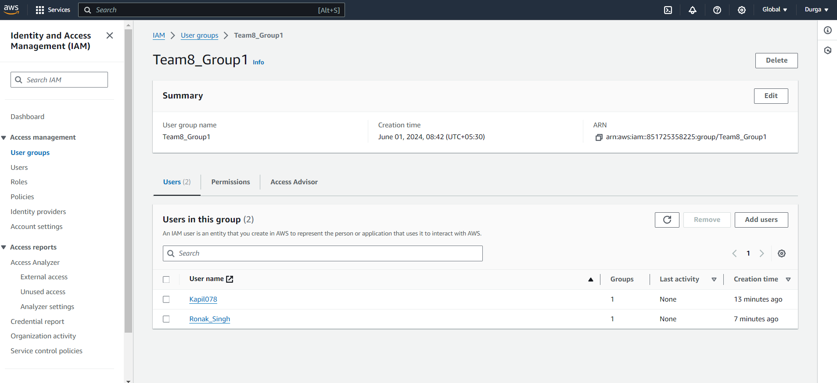
Likewise I created two Users and put them into the group

Slide 6
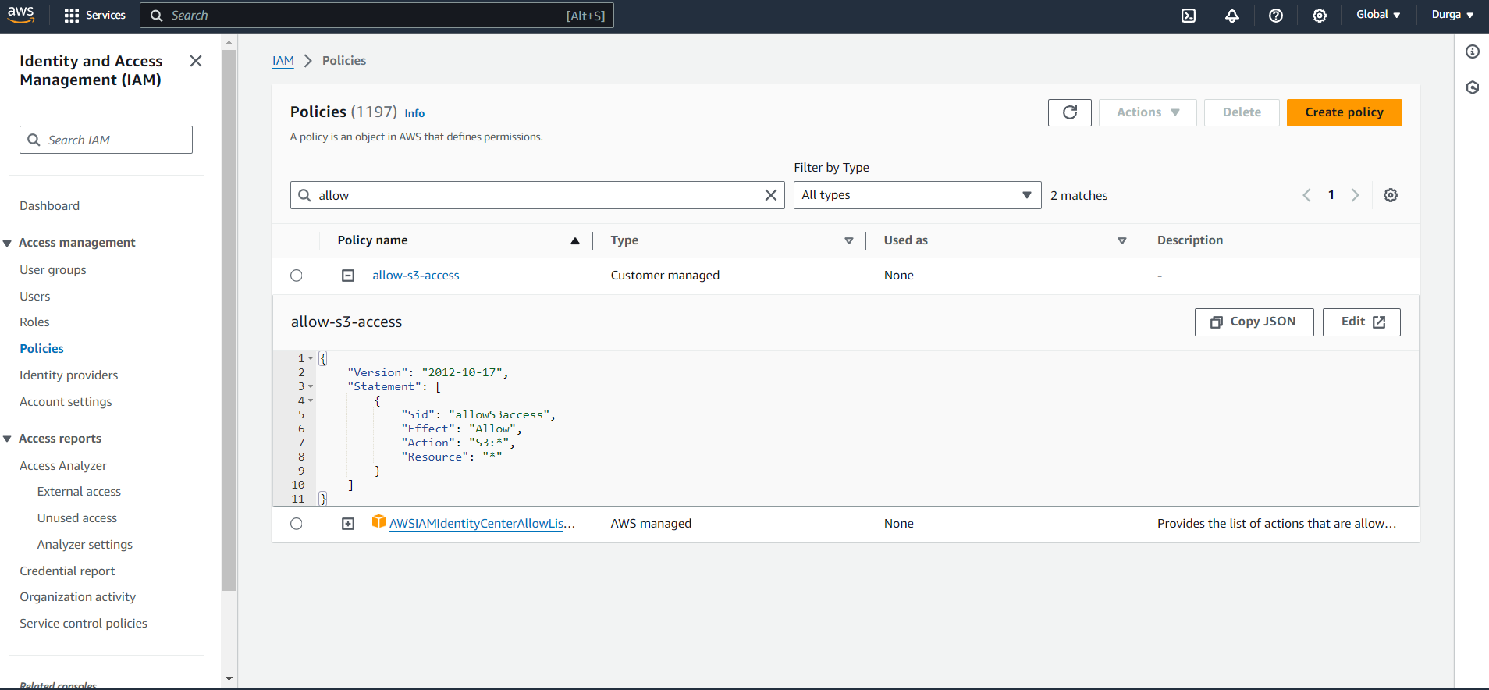
I created policies for the users

Slide 7
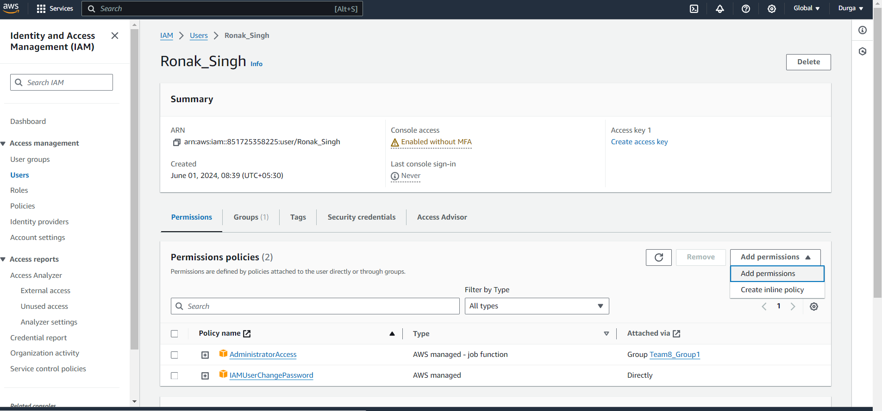
Next I gave specific permissions to the users

Slide 8
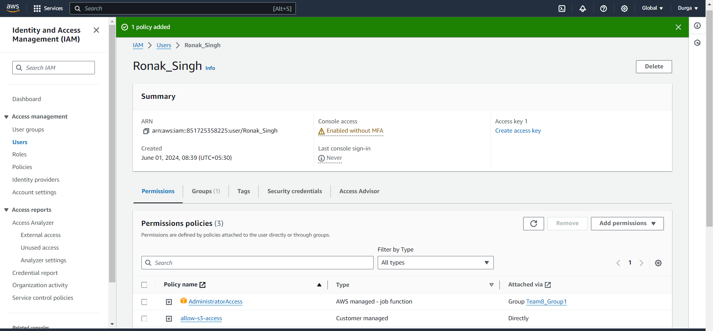
When Policy is added it looks like this

Slide 9
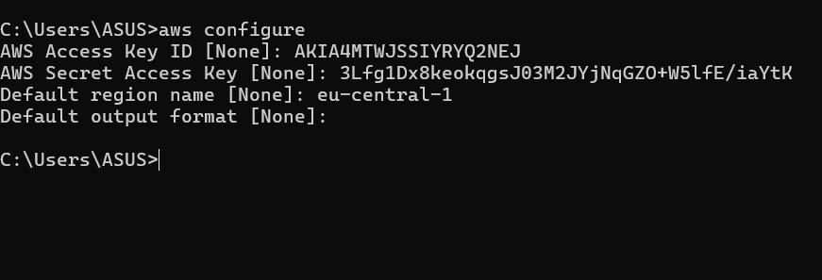




Configure AWS CLI and AWS SDKs on your local machine.

Slide 10
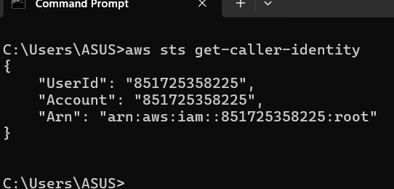









Slide 11
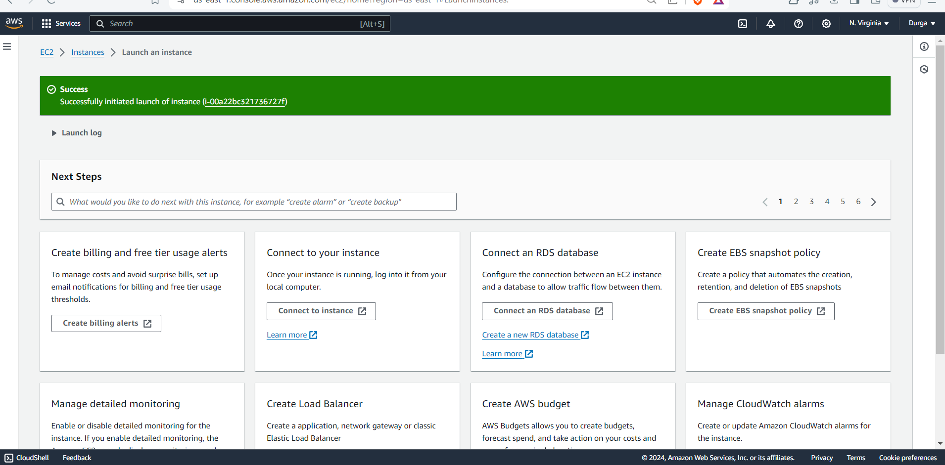
Task 2: Launch and Manage EC2 Instances
Launch a Linux/Windows EC2 instance.

Slide 12
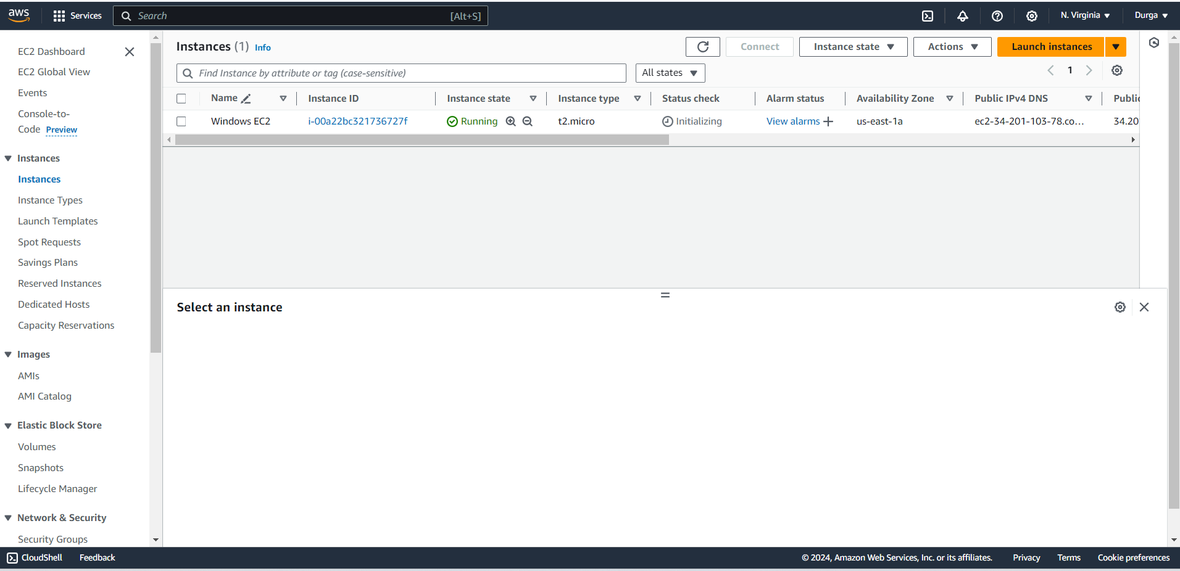

Slide 13
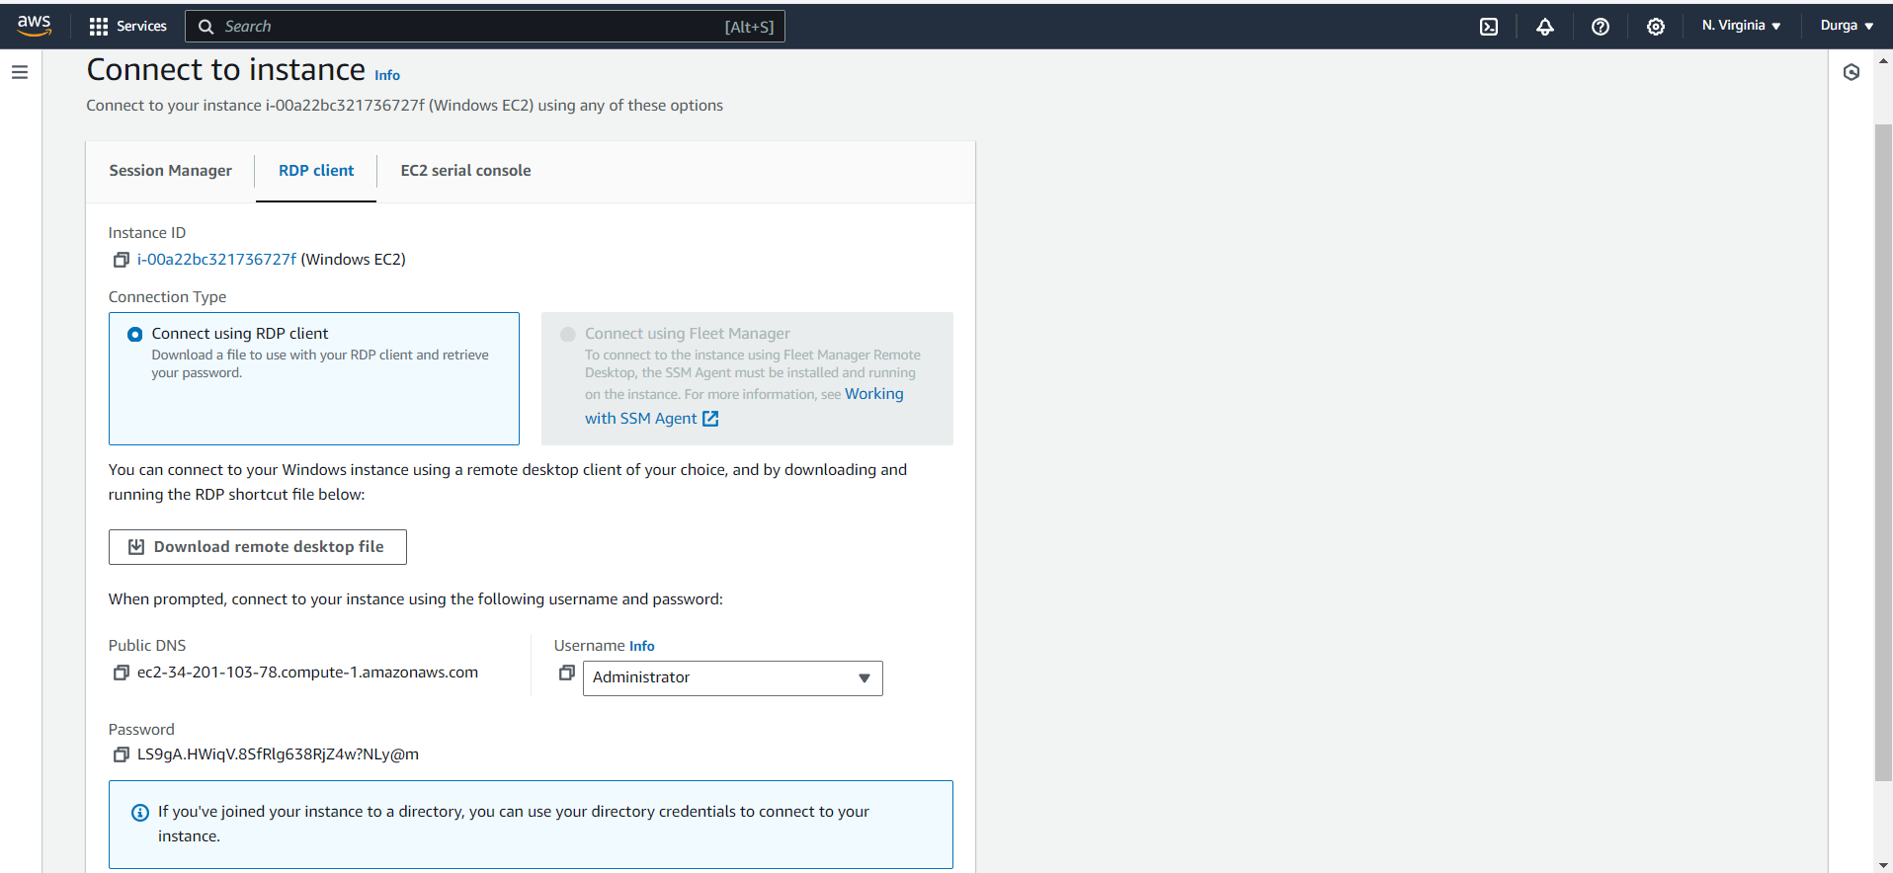
Connecting the instance via RDP

Slide 14
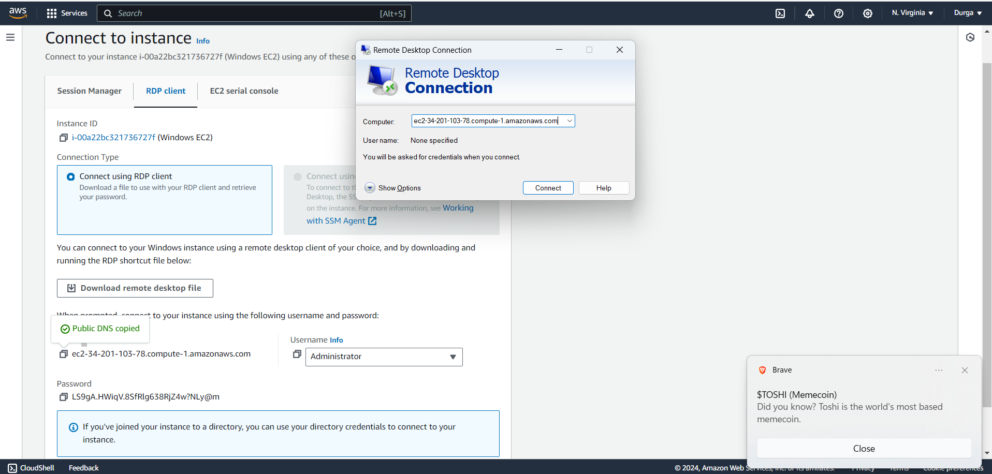

Slide 15
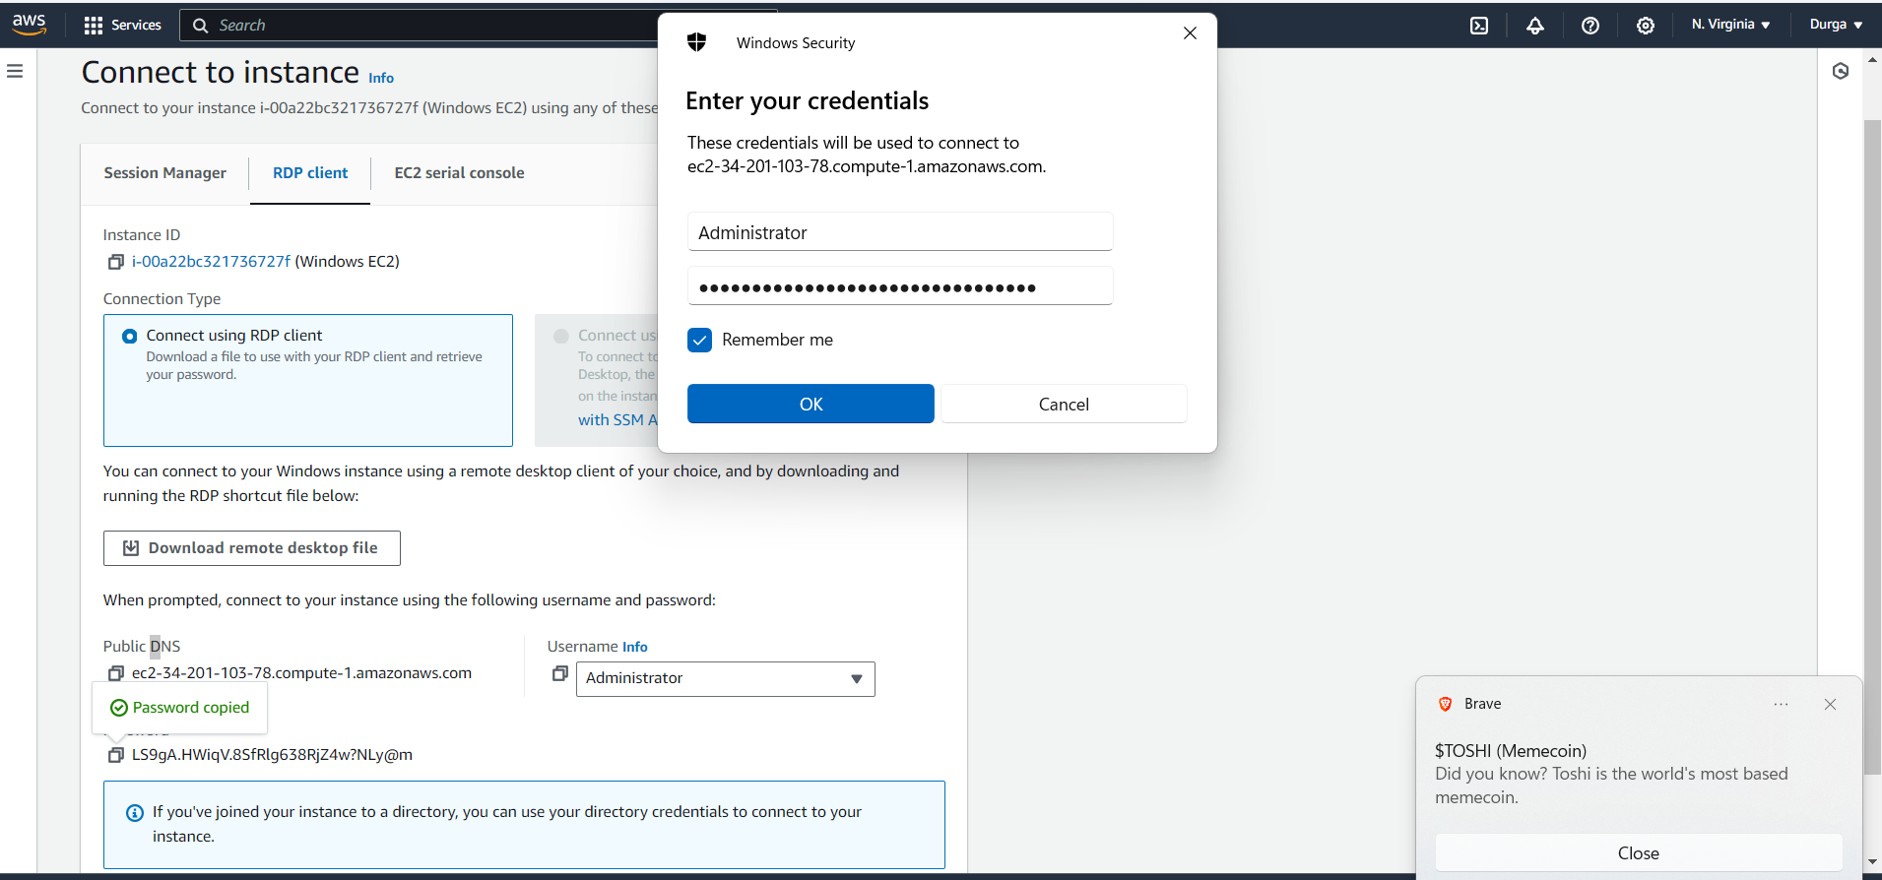

Slide 16
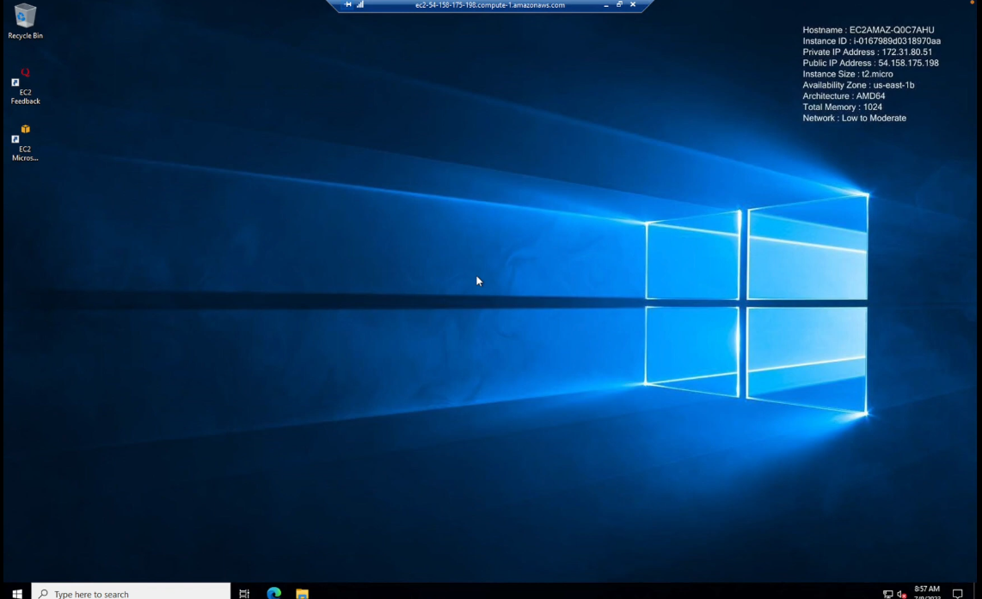
After Connecting the instance via RDP.
It looks like this in the Administrator

Slide 17
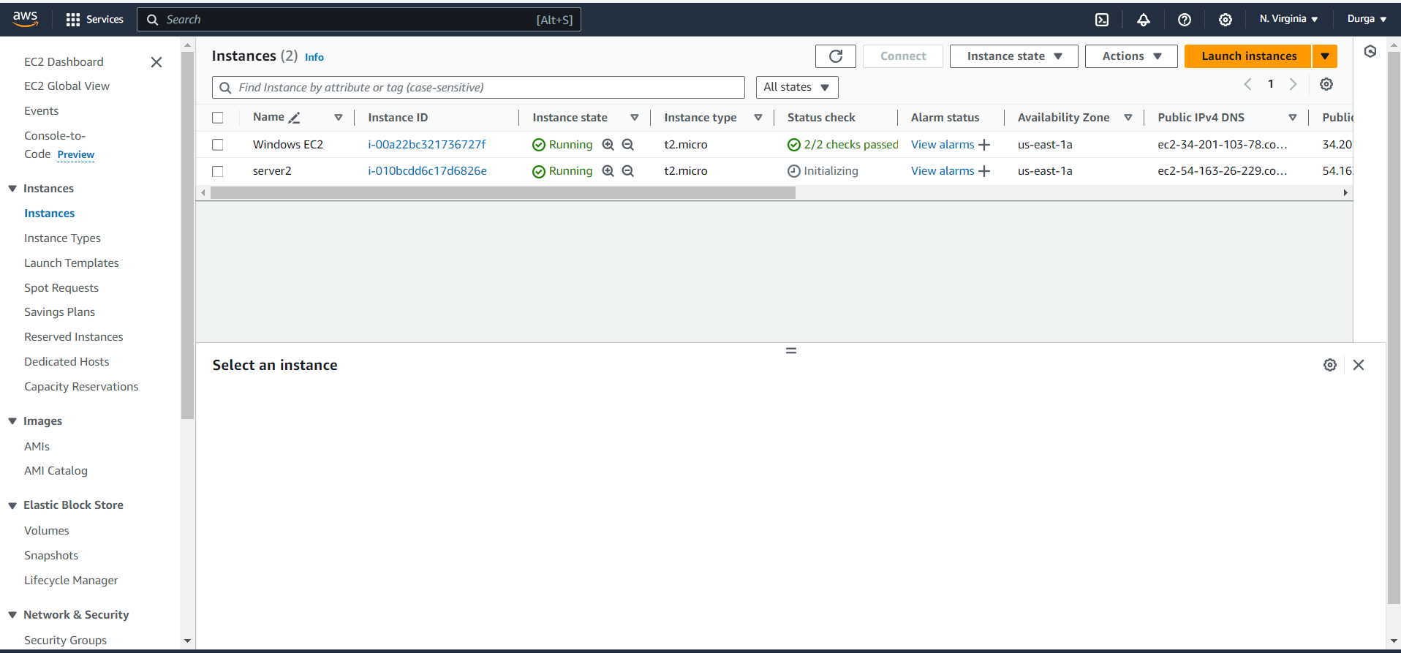
Install and configure a web server (Apache)
For this task I used Ununtu operating system , while making an instance(server2).

Slide 18
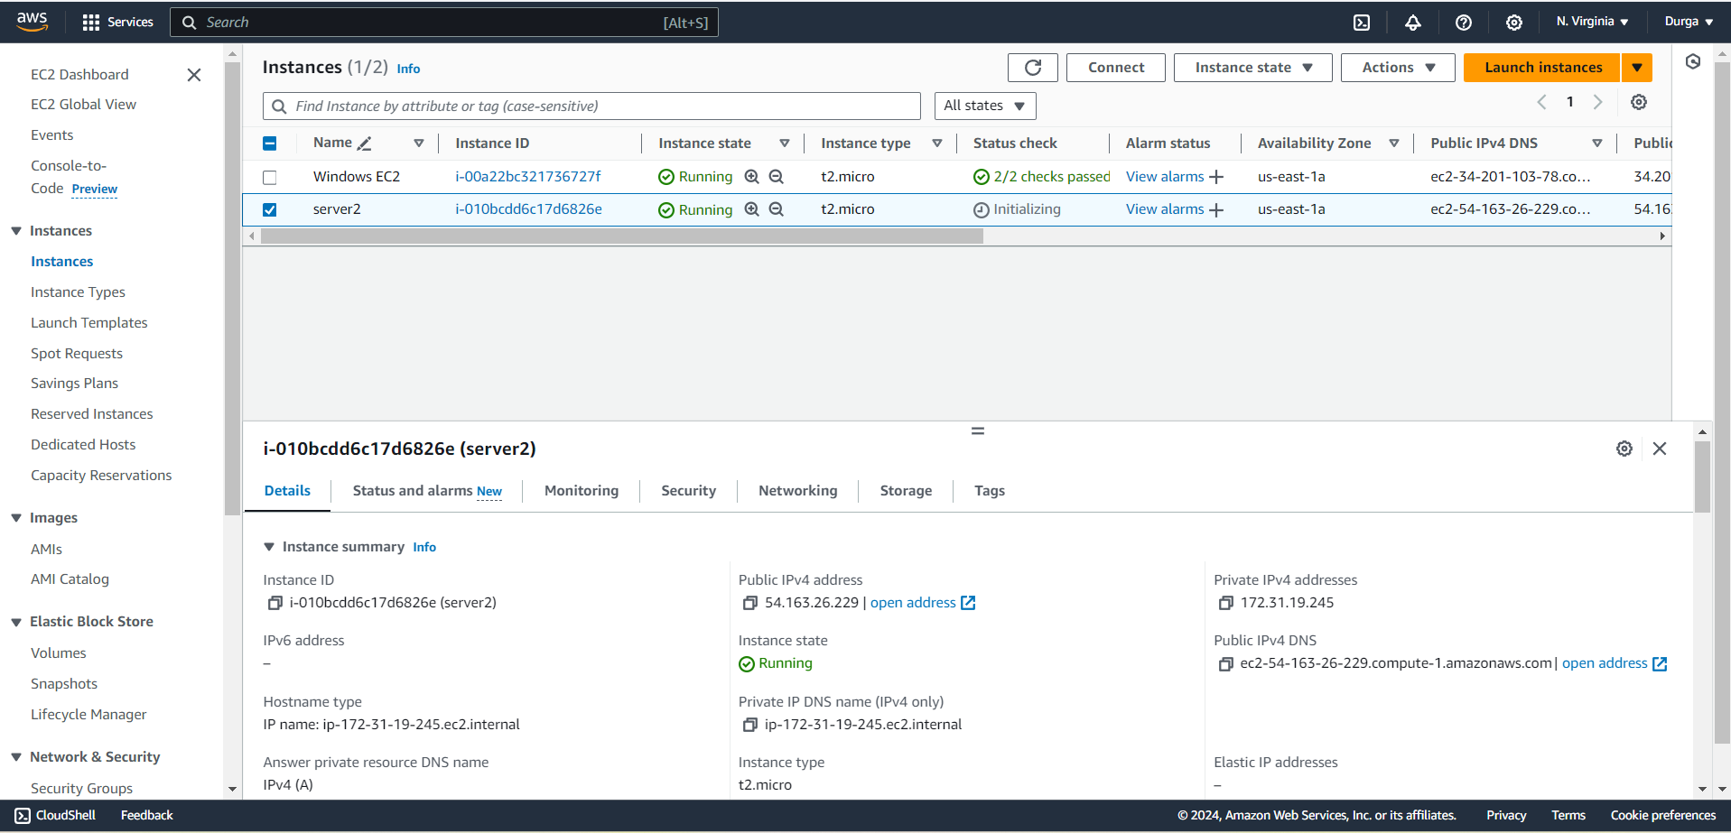

Slide 19
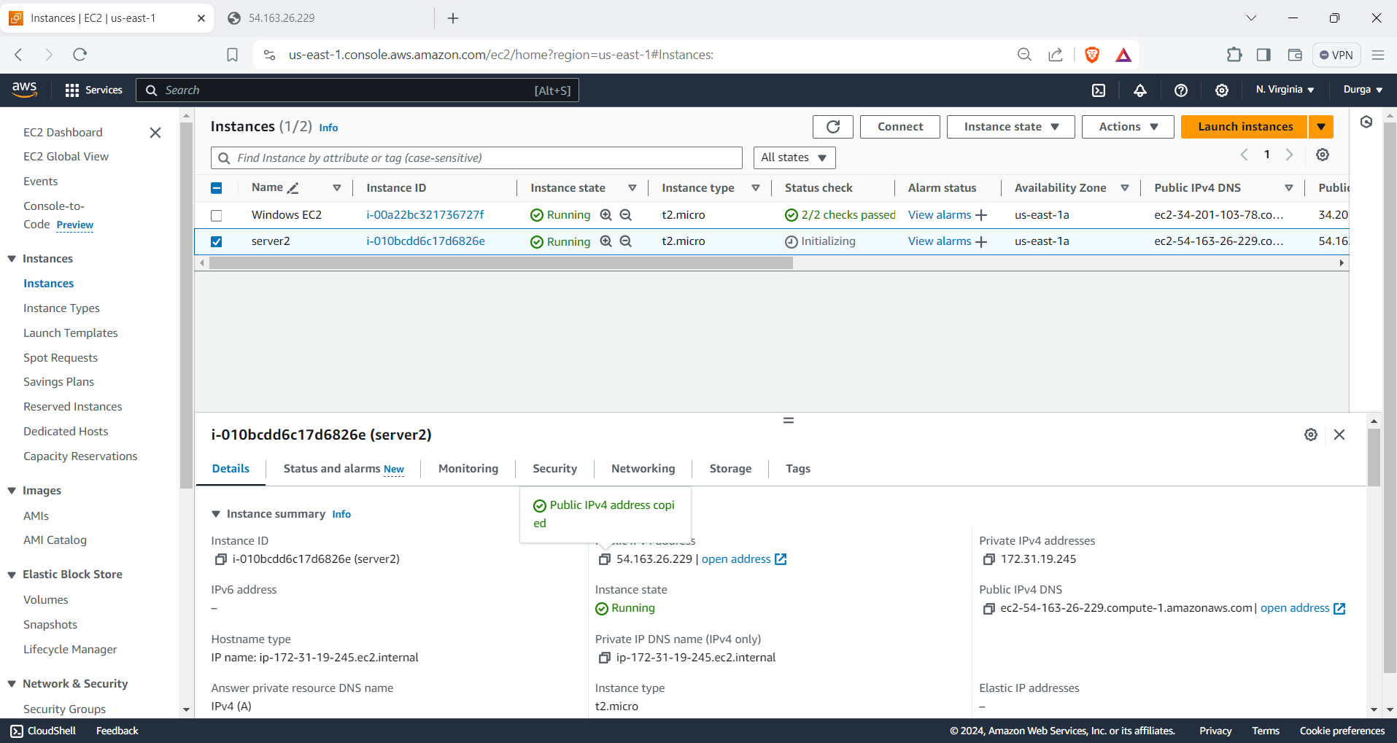

Slide 20
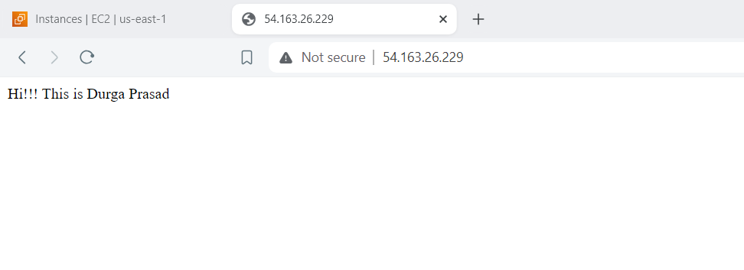
After Installation I Copied Public IPv4 address and pasted in new tab of web browser ,it resulted this:

Slide 21
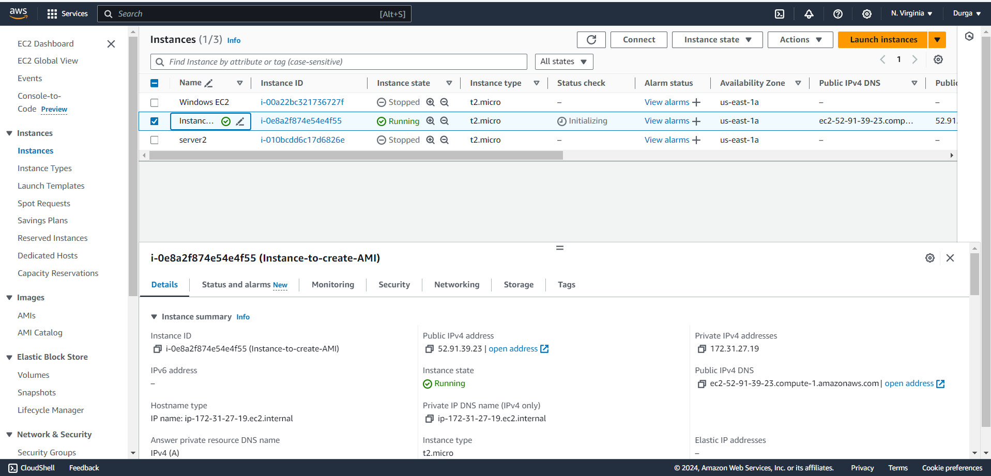
Create an AMI from your instance.
I Created a new Instance named(Instance-to-create AMI)

Slide 22
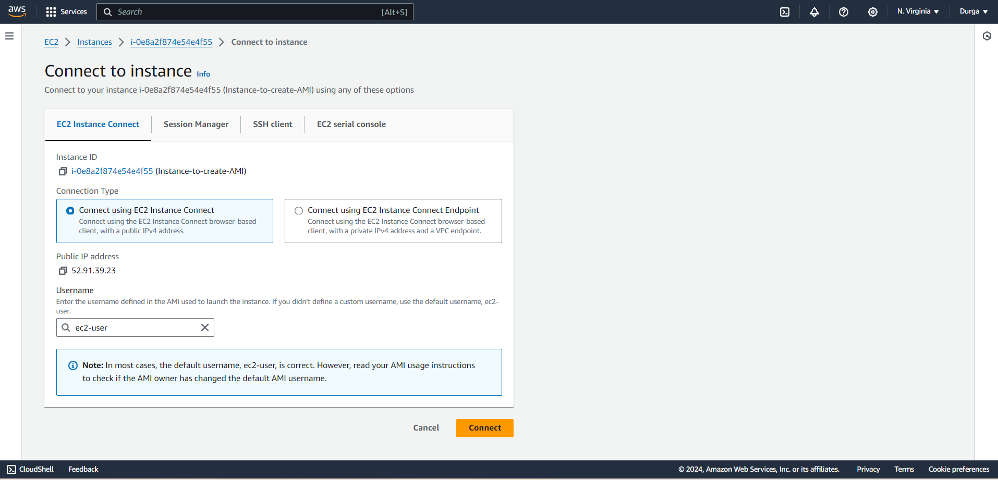
Connecting to Instance

Slide 23
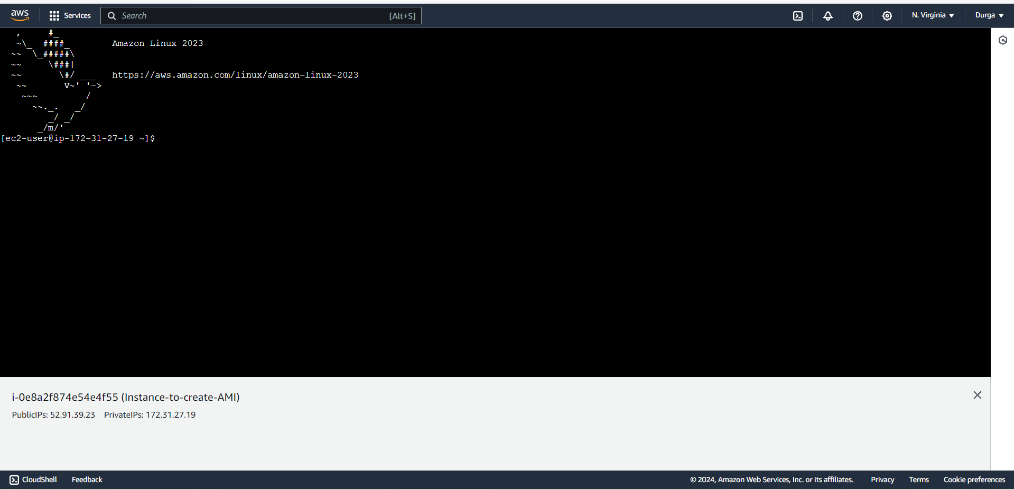

Slide 24
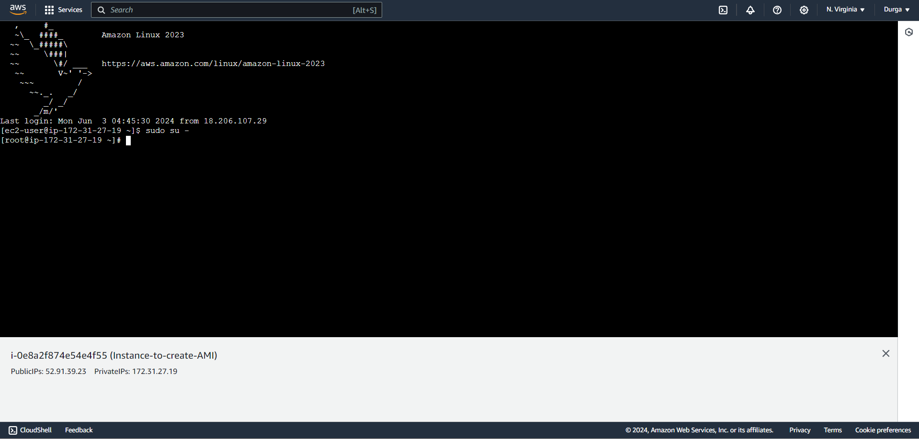
Log in as Root User

Slide 25
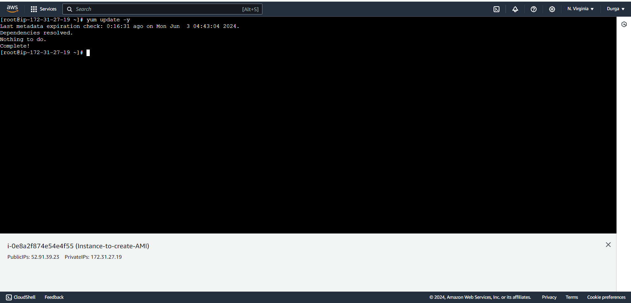
Update the System

Slide 26
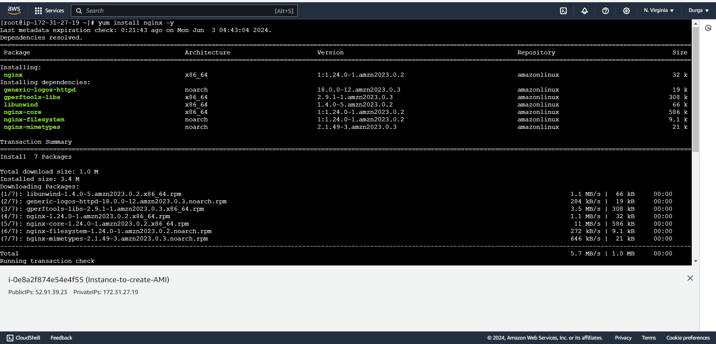
Install Nginx

Slide 27
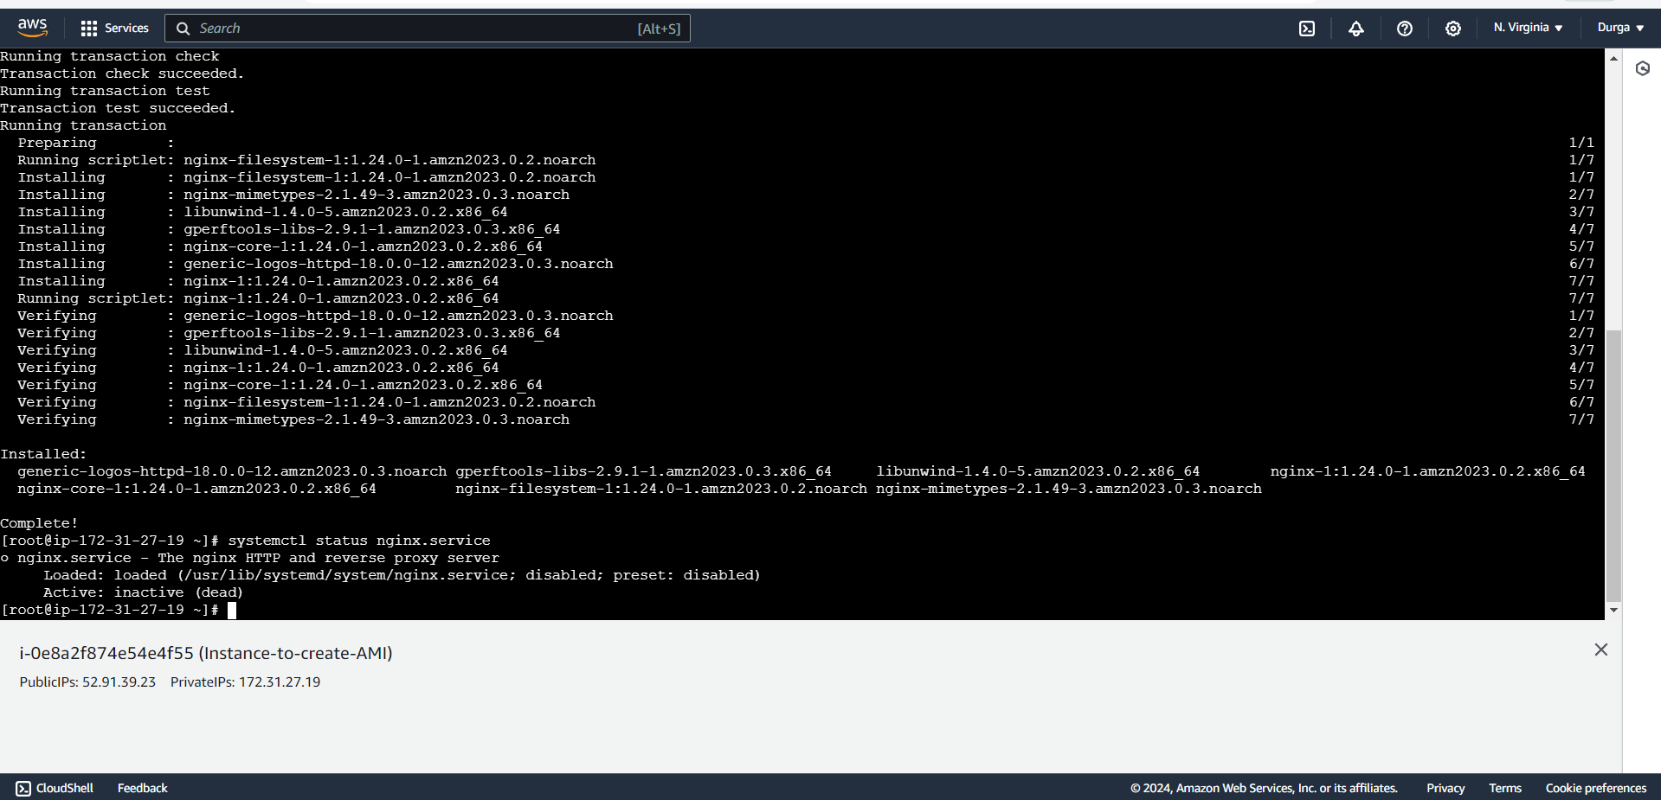
Status of Nginx Service

Slide 28
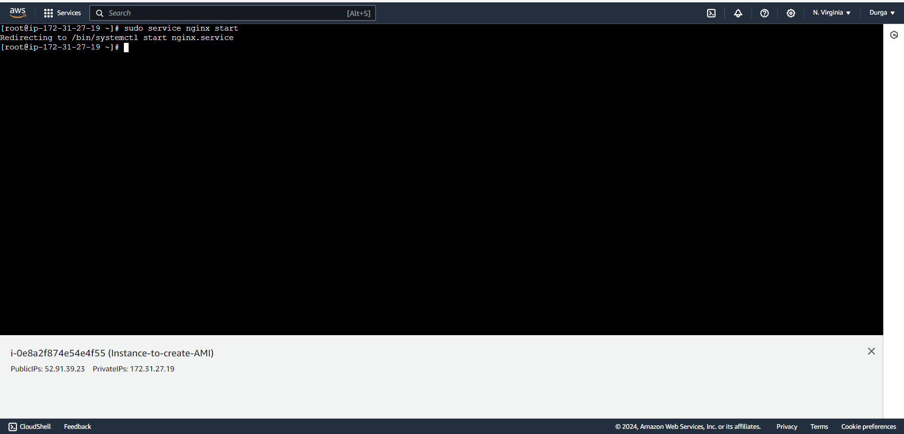
Start Nginx Service

Slide 29
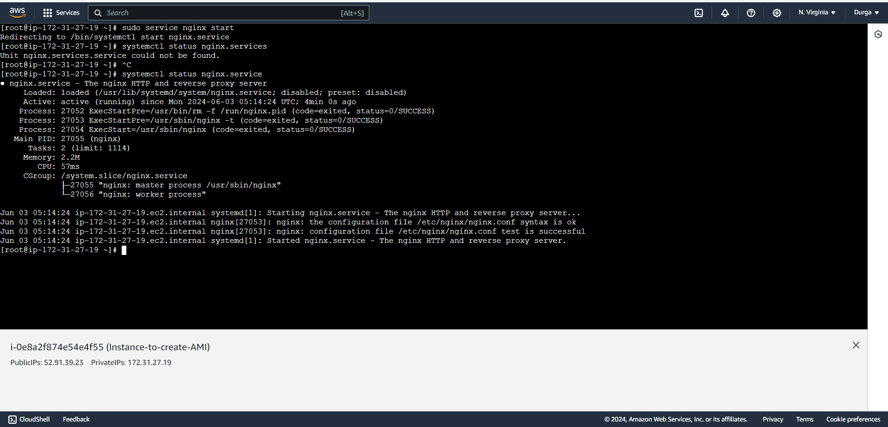
Now check the Status of Nginx Service again

Slide 30
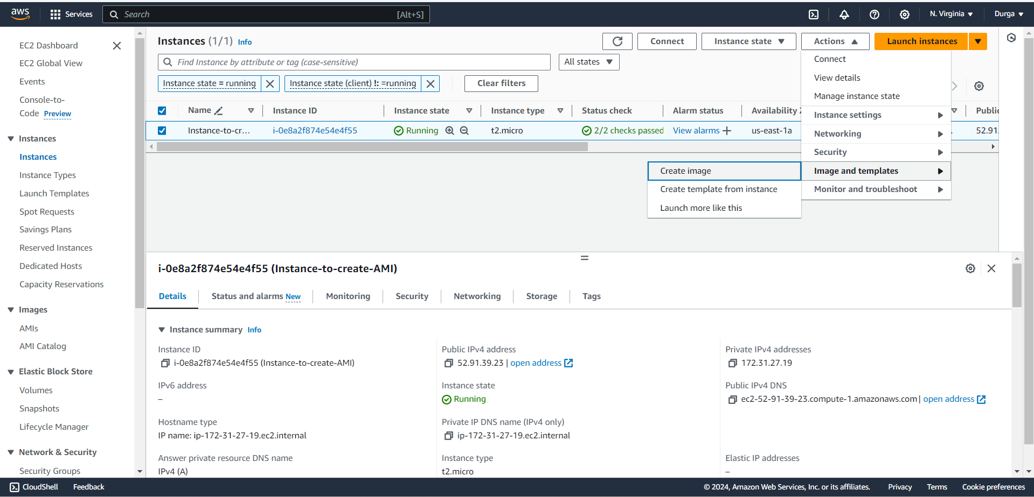
Creating an Image

Slide 31
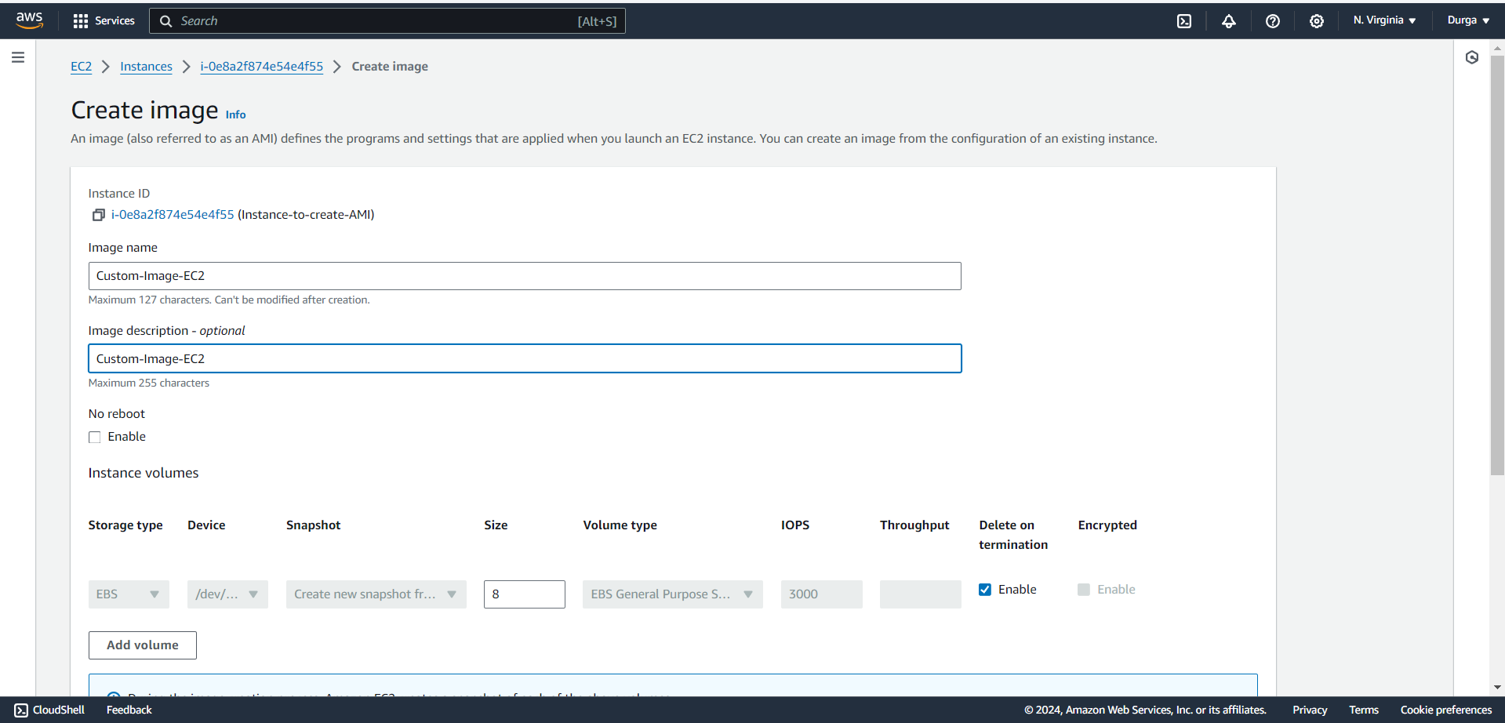

Slide 32
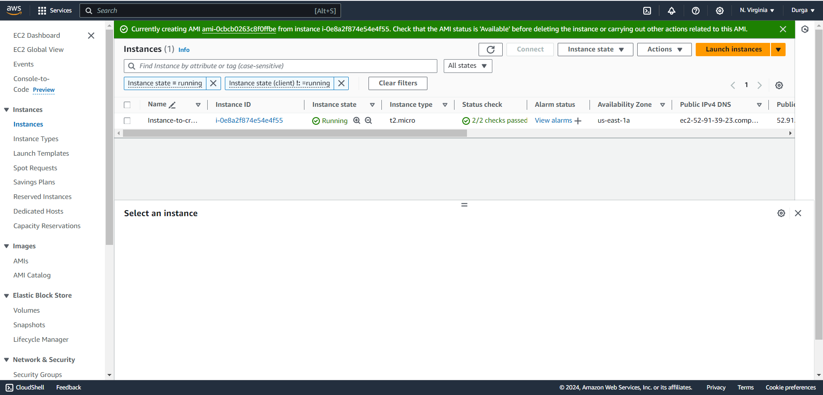
AMI is Created

Slide 33
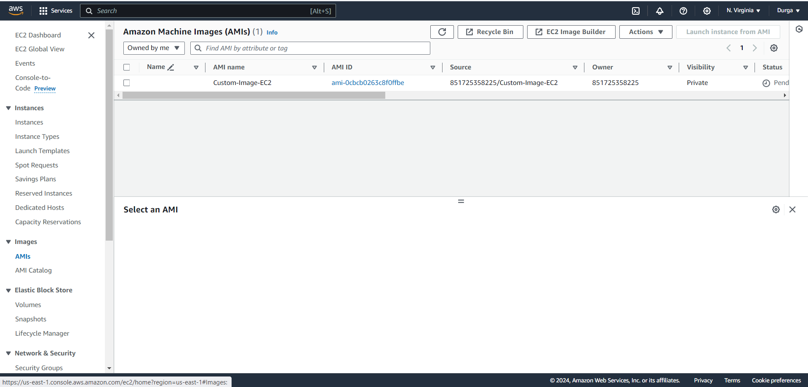
Image is Visible in AMI

Slide 34
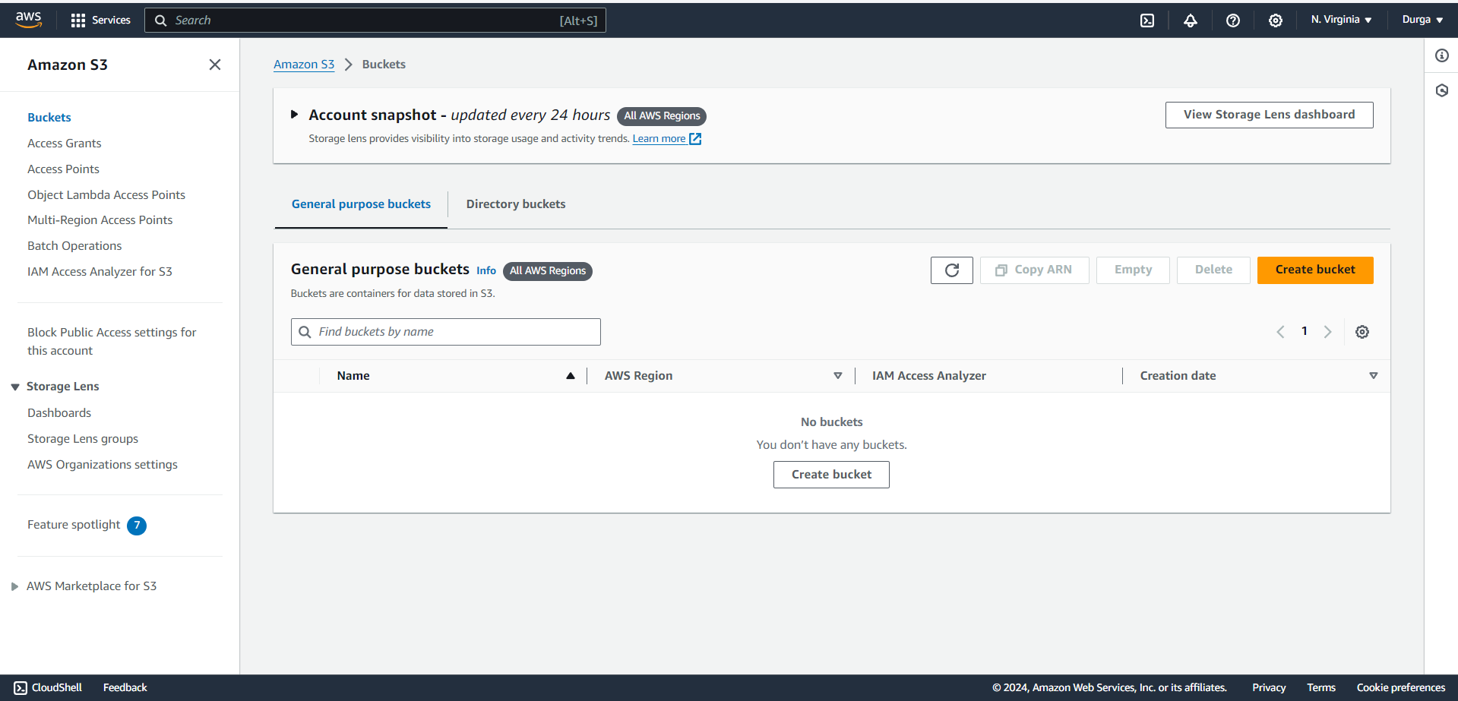
Task 3: Set Up and Configure S3 Buckets
Creating a S3 bucket.

Slide 35
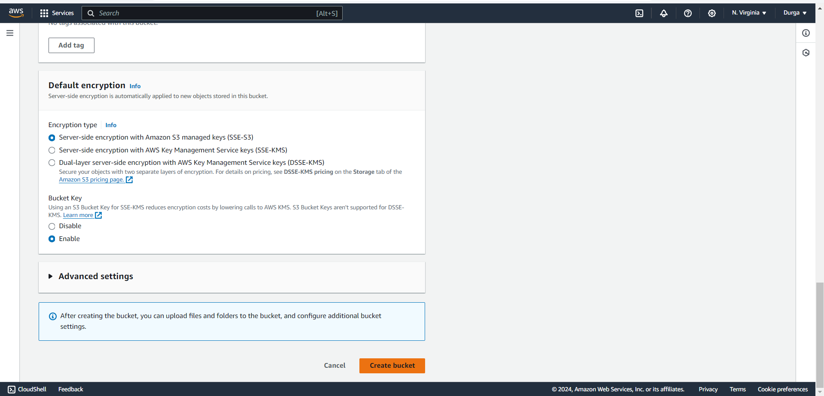
Name of the bucket is “gonecrazy”

Slide 36
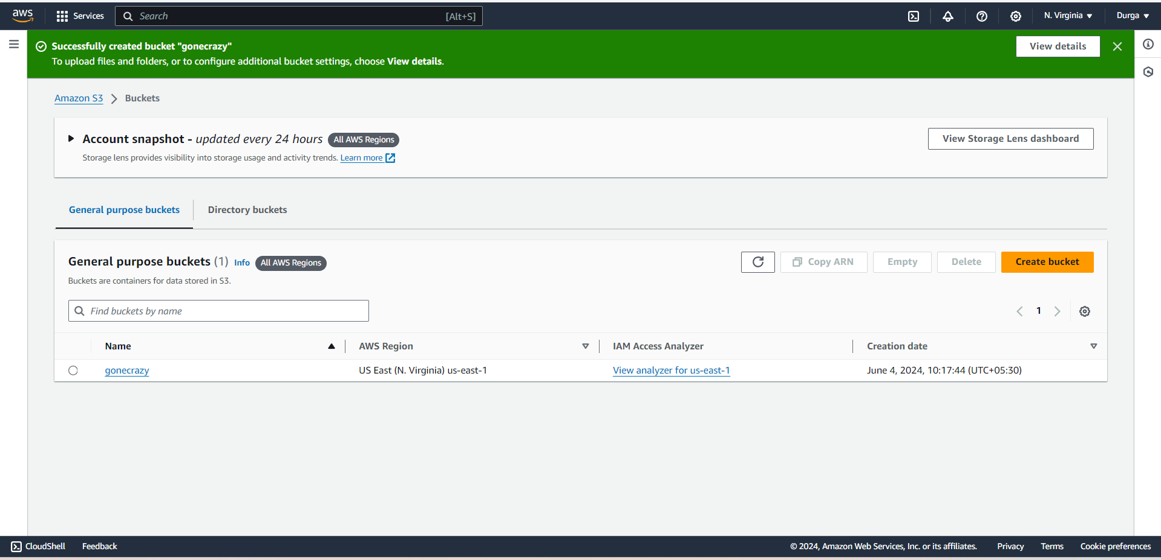

Slide 37
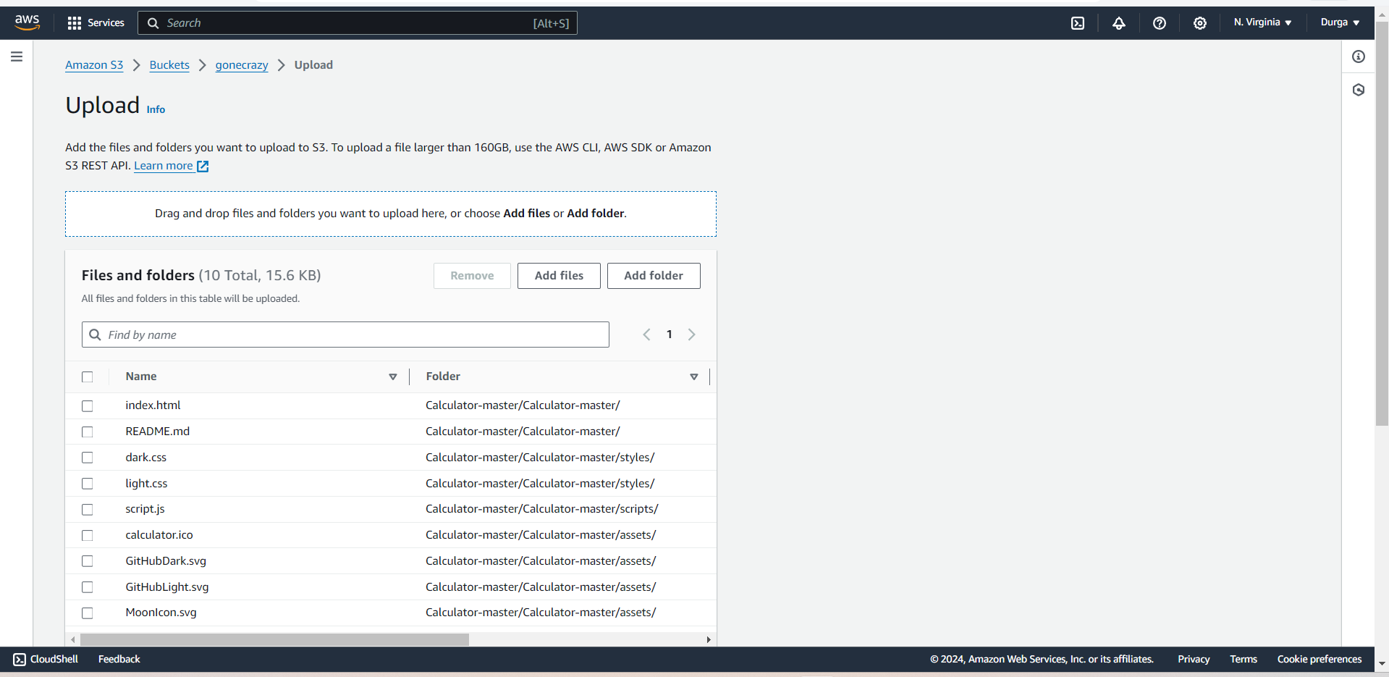
Upload, retrieve, and manage objects within the bucket.

Slide 38
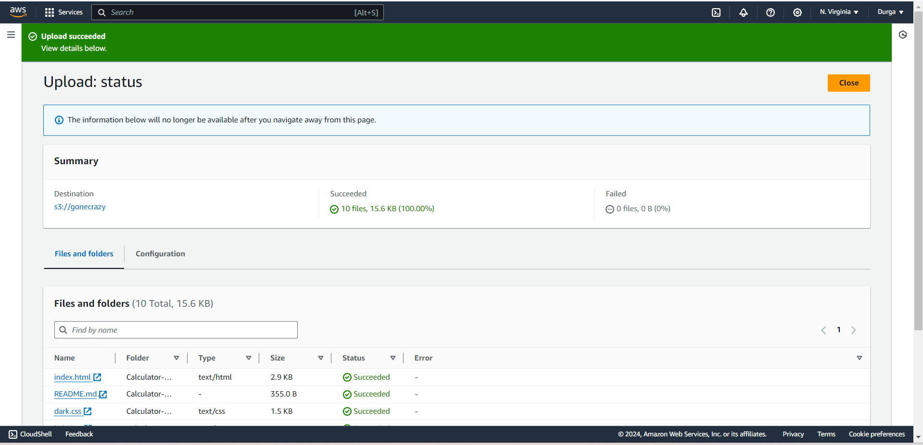

Slide 39
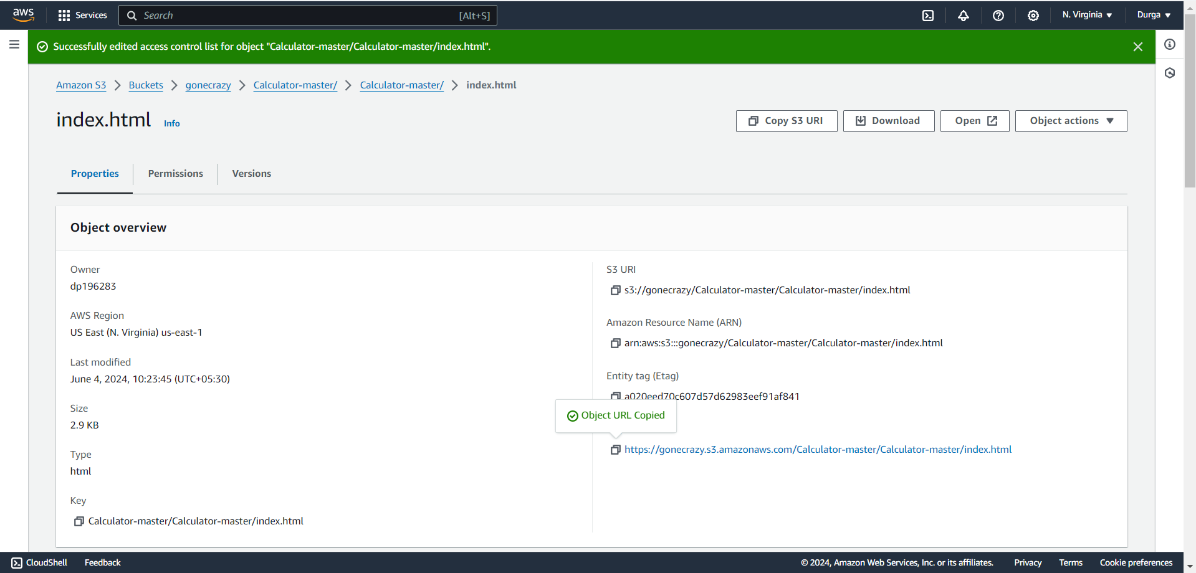
After giving permissions to the object and now it is public

Slide 40
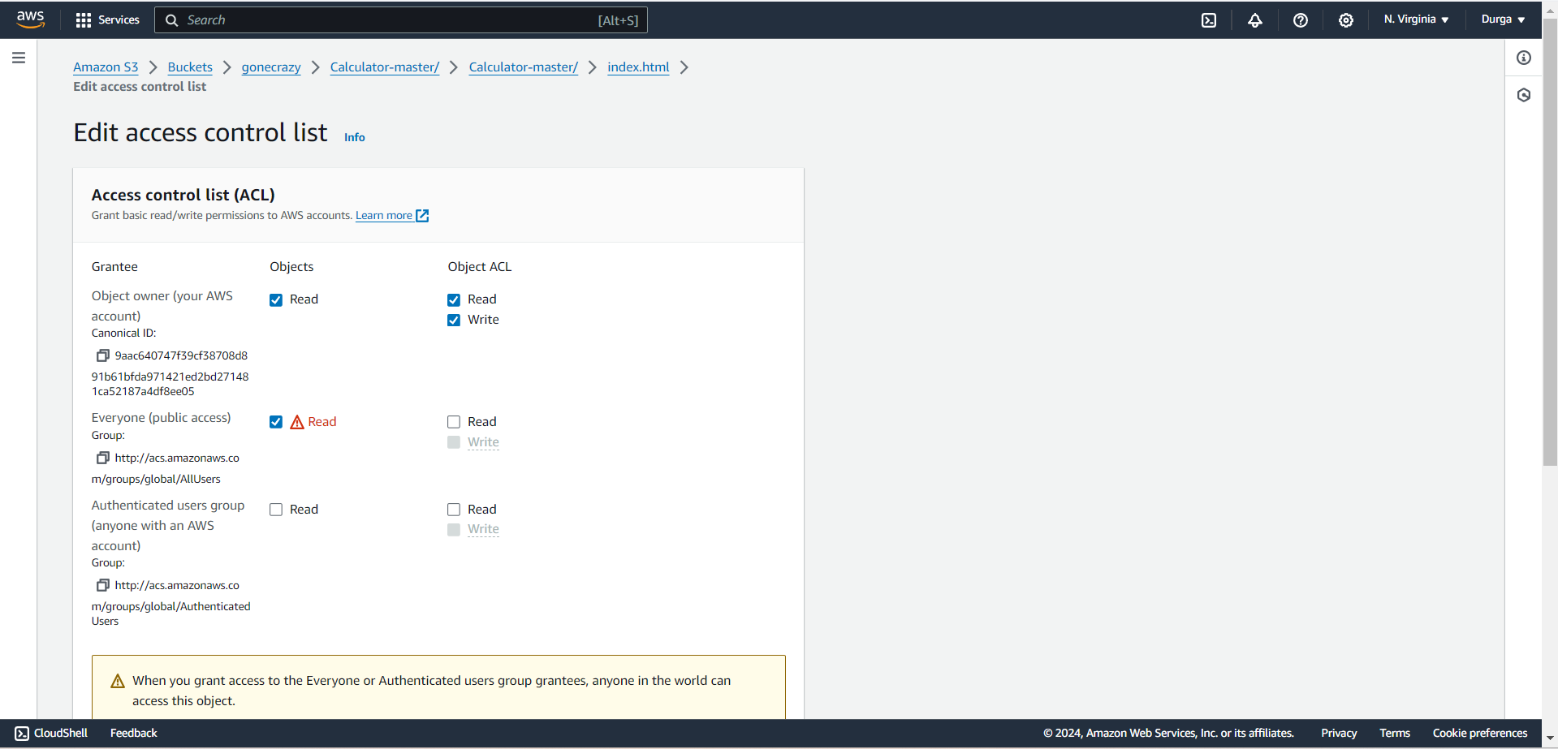
Access control lists (ACLs).

Slide 41
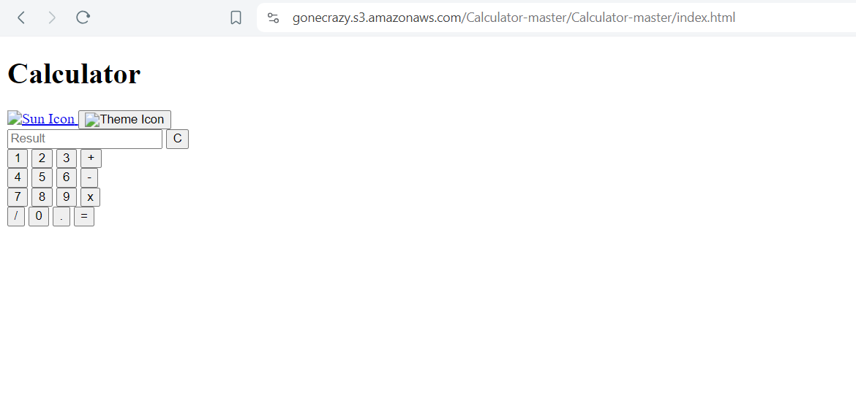
After Modifying ACL , I Copy pasted the Object URL in web browser

Slide 42
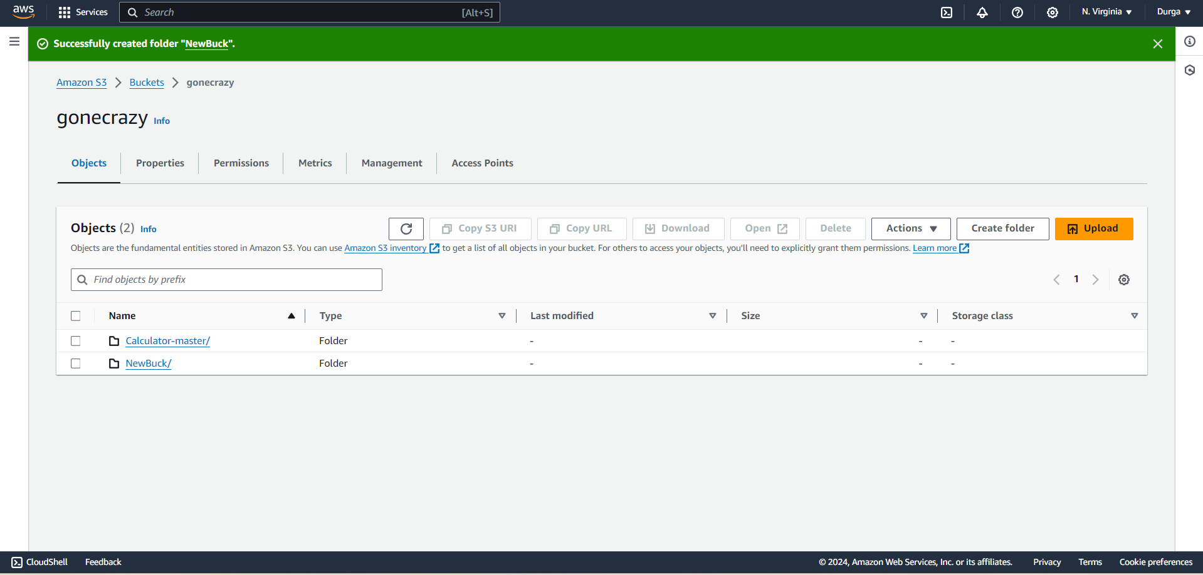
Creating new object in Bucket

Slide 43
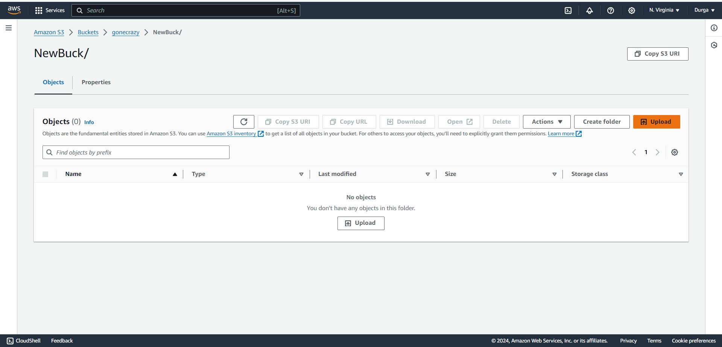
Uploading files in object

Slide 44
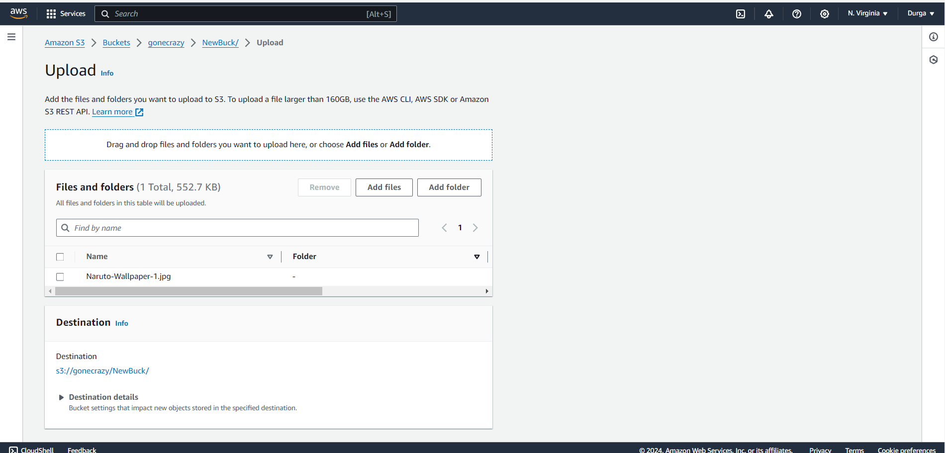

Slide 45
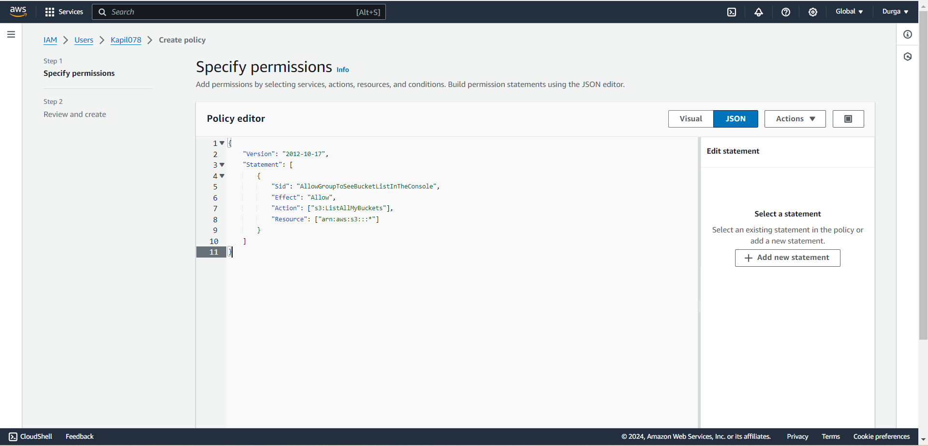
Bucket policies
List Buckets

Slide 46
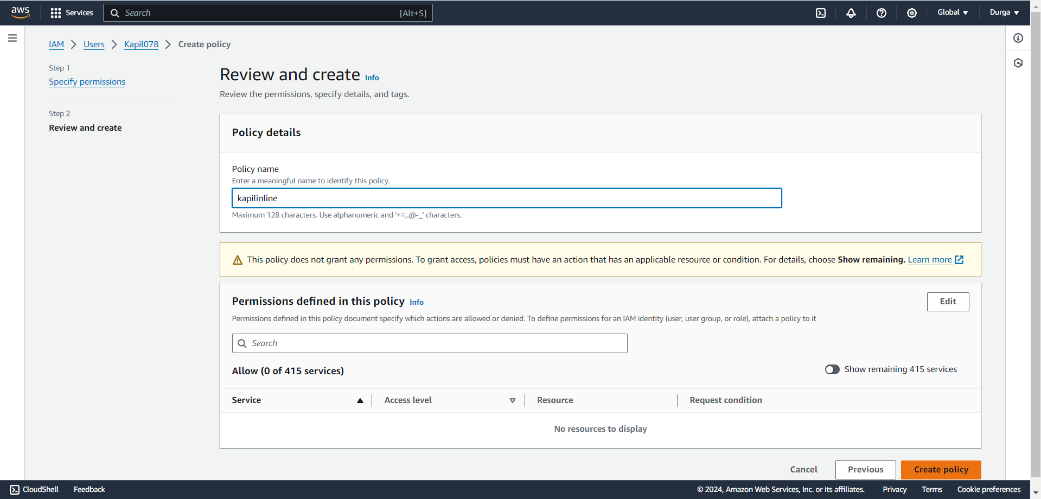

Slide 47
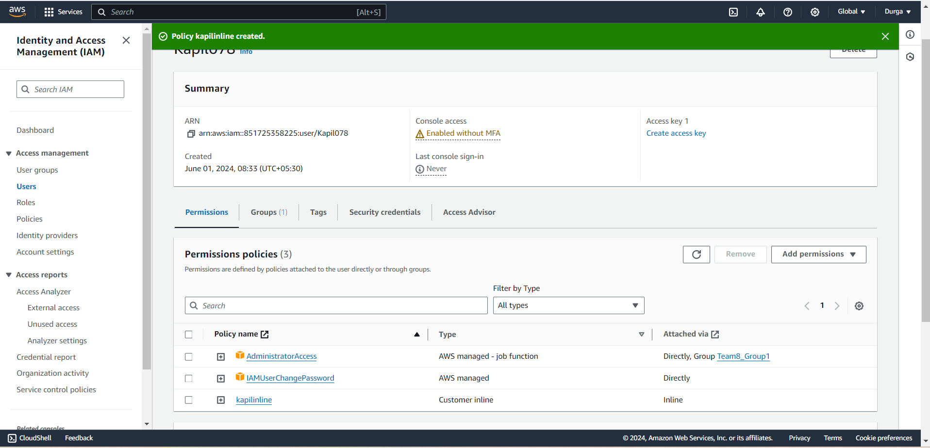

Slide 48
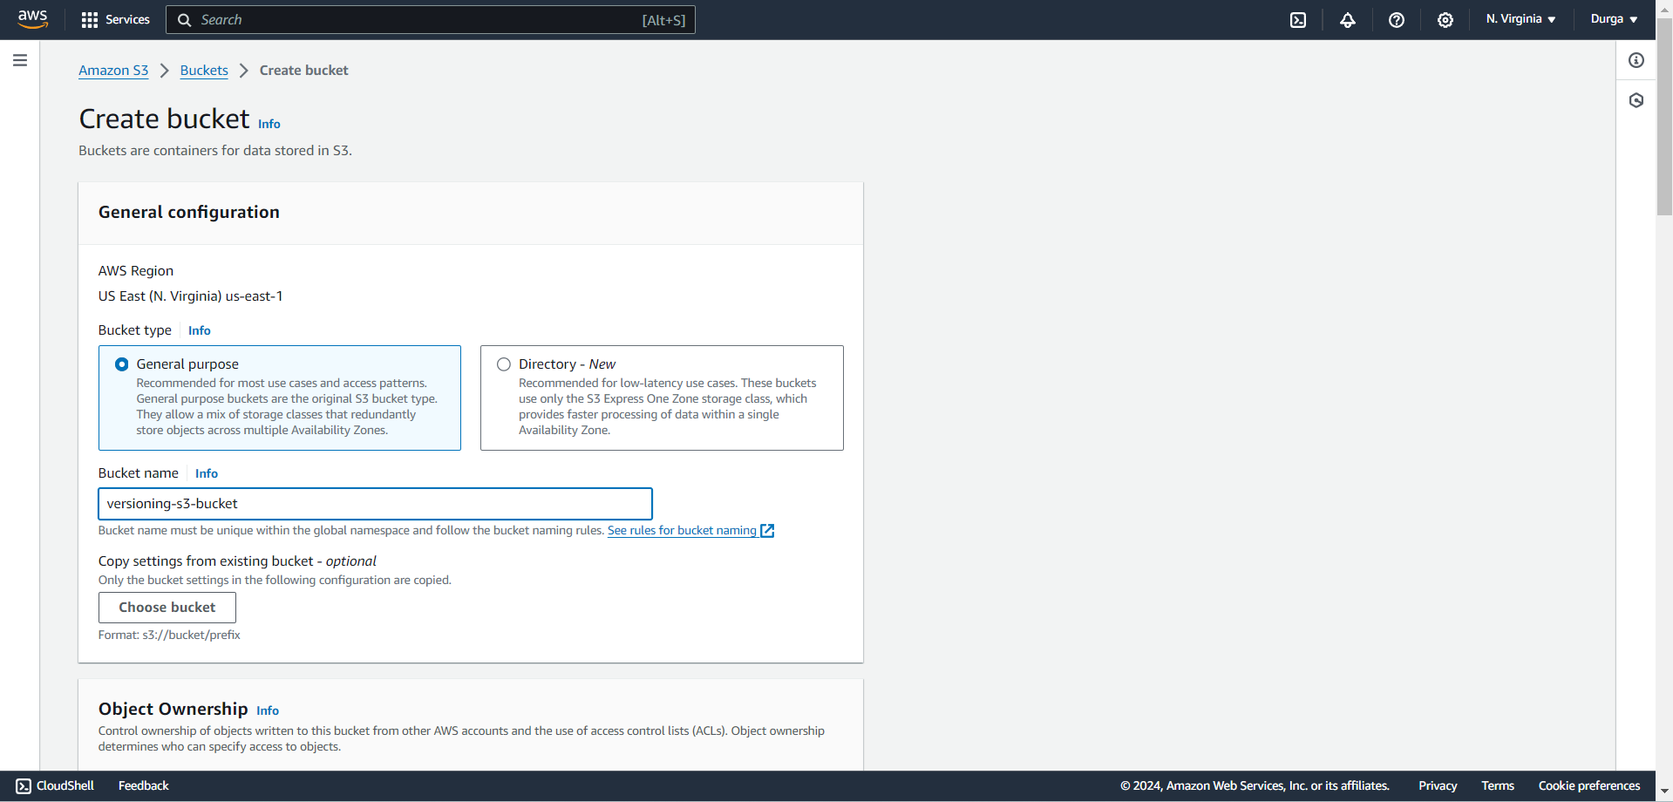
Enable versioning and lifecycle policies.
Enable versioning

Slide 49
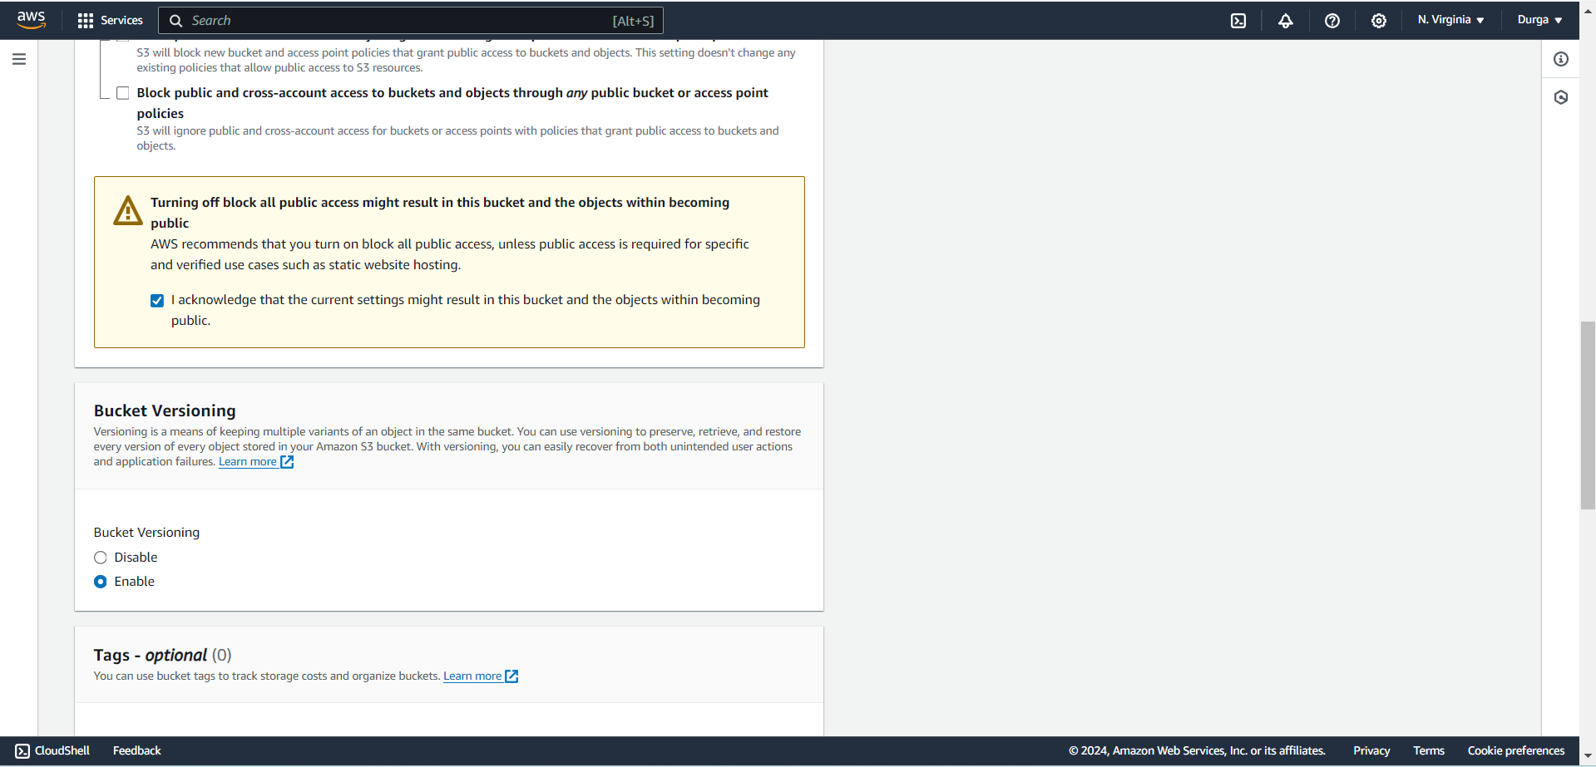
Create a but by enabling it’s versioning

Slide 50


Slide 51
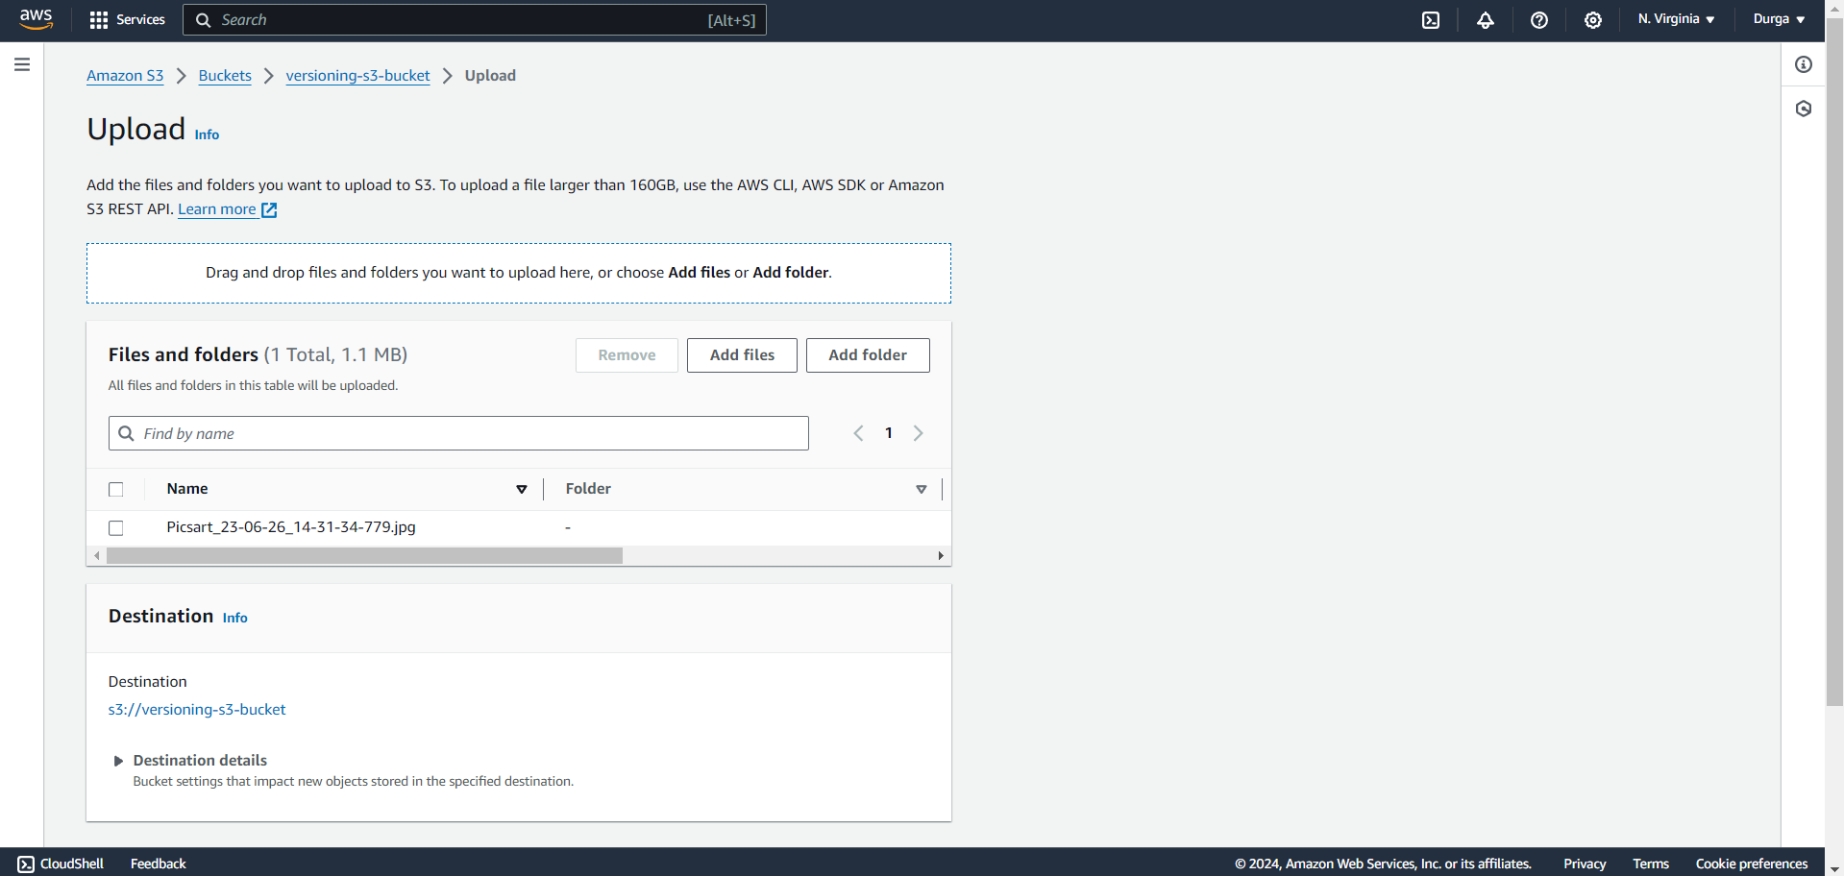
Upload files in the Object

Slide 52
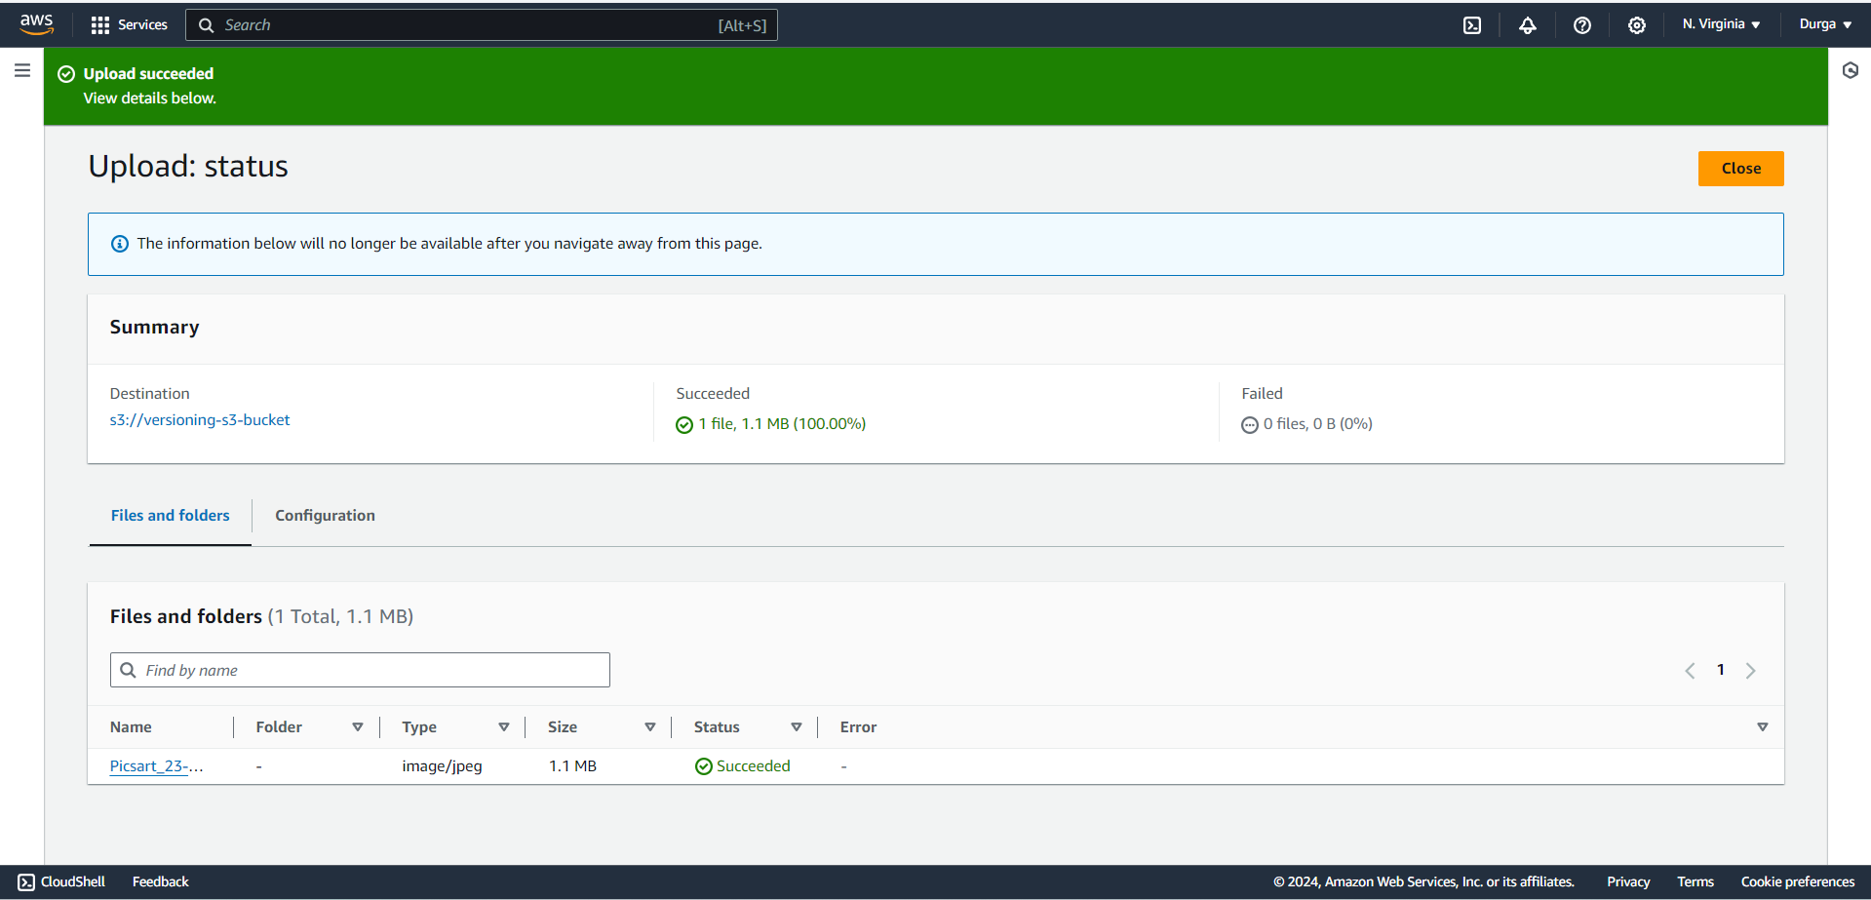

Slide 53
Once again Upload the Same file in the same object

Slide 55

After Enabling versions , it shows 2 different versions of same file

Slide 56


Slide 57

Creating lifecycle policies

Slide 58


Slide 59


Slide 60

Lifecycle Configuration is Created

